Slide 1
Annual Meeting October 7, 2022

Slide 2
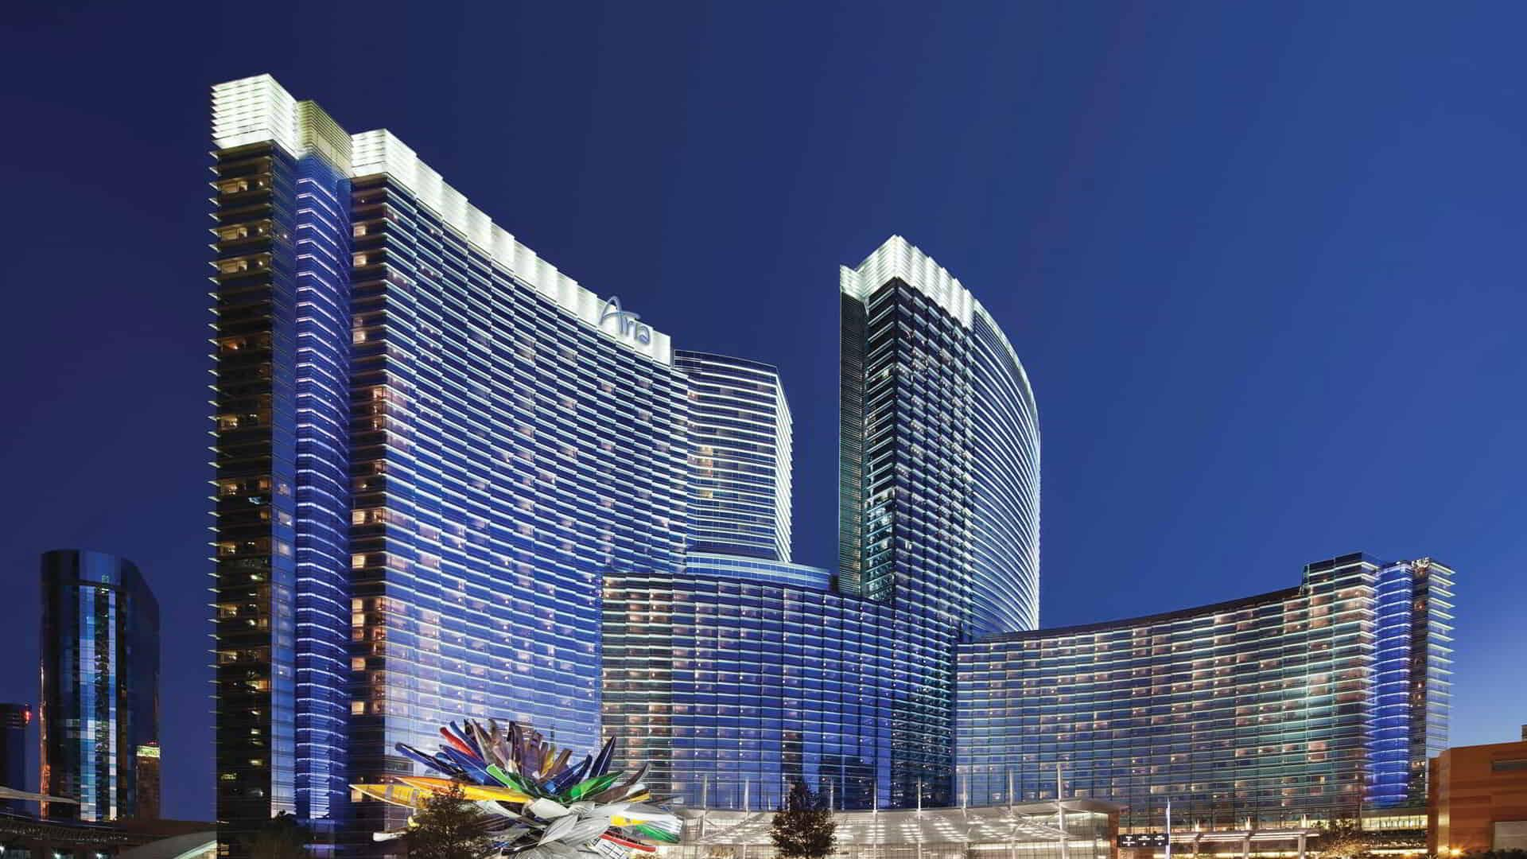
Aloha Welcome to Aria Resort & Casino

Slide 3
Agenda
1) Welcome Message – Marvin Yoshizumi, Executive Chairperson
2) Review Anti-Trust Guidelines, Row call – Michael Sutton, Secretary / Treasurer
3) Approve Minutes October 7, 2021 Virtual Annual Meeting
4) Annual Financial Report – Michael Sutton
5) Elections – Marvin Yoshizumi
6) Technical Committee Discussion – Bryan Moore
7) Proposed 2023 annual meeting
Enclosures:
2021 Minutes
2022 Ballot
EASI Cheat sheet

Slide 4
Anti-Trust Guidelines
DO NOT discuss your prices or competitors’ prices with a competitor (except when buying from or selling to that competitor) or anything which might affect prices such as cost, discounts, terms of sale, or profit margins.
DO NOT agree with competitors to uniform terms of sale, warranties, or contract provisions.
DO NOT agree with competitors to divide customers or territories.
DO NOT act jointly with one or more competitors to put another competitor at a disadvantage.
DO NOT try to prevent your supplier from selling to your competitor.
DO NOT discuss your future pricing, marketing, or policy plans with competitors.
DO NOT discuss your customers with your competitors

Slide 5
Anti-Trust Guidelines
With respect to this meeting:
DO NOT make any statements regarding prices or matters affecting prices at this meeting.
DO NOT make statements about your future plans regarding pricing, expansion, or other policies with competitive overtones. Do not participate in discussion where other attendees do.
DO NOT propose or agree to any standardization, which will injure your competitor.
DO leave any meeting where any of the foregoing topics are being discussed – and state why you are leaving.
DO NOT attend or stay at any informal meeting where there is no agenda, no minutes are taken, and no staff member is present.
DO NOT assume you are protected by information advice from a governmental official.
DO NOT speak as a formal representative of this group about the meeting.
DO alert staff to anything inaccurate or improper. This includes a position the group has taken or intends to take or a meeting or activity of which you have learned.
DO send copies to a staff member of any communications or documents sent, received, or developed by you when acting for the group.
DO NOT do anything before or after this meeting, or at social events, which would be improper at a formal meeting.
DO alert every employee in your company who deals with the group to these guidelines.
DO be conservative. If you feel an activity might be improper, do not do it

Slide 6
Annual Financial Report
For the period Oct 1, 2021 to Sep 30, 2022
Beginning Balance Oct 1, 2021 $21,111.94
Deposits:
2021 Donations 482.06
2022 Meeting Fees 5,729.69
Total Deposits: 6,211.75
Expenses:
GO Daddy email svc (143.88)
CSC fees (tax filing & rep fees) (686.00)
WIX.COM (website fees) (49.90)
Total Expenses: (879.78)
Ending Balance Sep 30, 2022 $26,443.91

Slide 7
Elections 2022 Ballot
For service on the steering committee the following persons have been nominated and agreed to serve for a 2 year term. Voting privilege is granted to all Corporate Members regardless of their classification.
TREASURER / SECRETARY VOTE FOR ONE
Jeremy Wingo (LAT)
Nominated from the floor:
______________________________
VICE CHAIRPERSON VOTE FOR ONE
Diana Priebe (Gildan)
Nominated from the floor :
______________________________
AT- LARGE MEMBERS VOTE FOR AS MANY AS YOU WISH
Marvin Yoshizumi (American T- Shirt Co)
Nominated from the floor:
Michael Sutton (Hanes), Betsy Burton (S&S Activewear),
Keith Schneider (Alphabroder), Jeremy Wingo (LAT)
Election Results: All above have been elected by simple majority.

Slide 8
Proposed 2023 Annual Meeting
Hawaii
Bahamas
Texas
Miami
Kansas City

