Slide 1
Changes to Master Carton and Shipment Label Specifications
Document created as part of Phase I
Last updated November 2002
Recommended changes presented at 2012 meeting
While updating we found a few other areas of the document that needed to be updated

Slide 2
Summary of Changes
Cover page
  Updated name of group from Embellished Activewear Industry Supply Chain Integration Standards
  To Embellished Activewear Standards Initiative
  Revision date is April 2013 (v. November 2002)
Page 2
  Corrected wrong information
    2) Label Purpose – To be used on a single container holding one or more items with a single part number.
    2) Label Purpose – To be used on a single container holding a single part number.
  Removed outdated information
    Labels, printer, and printing software provided by Datamax and ADC Technologies

Slide 3
Summary of Changes continued
Page 5
  Corrected wrong data
    16.6 The numbers that that surround the GTIN 00707738003265 consist of an (02) and an (03). The (02) is found to the left is an Application Identifier (AI).
    16.6 The numbers that that surround the GTIN 00707738003265 consist of an (02) and an (37). The (02) is found to the left is an Application Identifier (AI).
Page 8
  Added clarification
    The third label (Figure 5) is the Shipment Label. It is used to link the shipment to the electronic ASN file.
    The third label (Figure 5) is the Shipment Label. It is used to link the shipment to the electronic ASN file. Please note that the Shipment Label is optional.

Slide 4
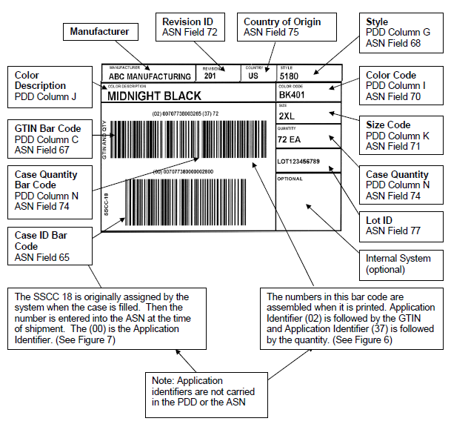
Summary of Changes continued
Pages 9, 10 and 11
Correct Field # References to ASN & PDD
Examples of Call out reference corrections:
  Revision ID
    ASN Field 72 changed to ASN Field 10
  GTIN Bar Code
    ASN Field 67 changed to ASN Field 5
    PDD Column C changed to PDD Field 4
Similar updates to file references on Pages 12 & 13

Slide 5
Summary of Changes continued
Updated and added references
  Page 5
    Application Identifier Reference was not a valid link
    Replaced http://www.uc-council.org/reflib/00403/d30-t.htm with http://www.gs1-128.info/ Appendix E
  Page 7
    Added Additional Information Regarding SSCC-18: http://www.gs1-128.info/sscc-18
    Added a note to the label examples and mapping paragraph:
    Please note that the field references are from the Detail section of the PDD 832 v7.0 and ASN 856 v5.0 file unless otherwise noted.

Slide 6
Questions and Comments?

