Slide 1
Introduction to EASI

Slide 2
Agenda
EASI History
EASI Benefits
What’s Next

Slide 3
EASI History – 16 years of progress
Late 90’s – early 00’s
Industry maturing, growth slowing, margins declining, SKU’s exploding
Technology changing – affordable, less complicated
Wholesalers consolidating and adding branches, sales volume and complexity expanding
More focus on cost of doing business
Lack of standardization becoming an issue

Slide 4
EASI History continued
Wholesalers
“We can’t take advantage of technology to improve efficiency and lower our costs because every supplier does things differently”.
Some begin internal standards and label the cases themselves.
Manufacturers
“We want to automate processes but every wholesaler wants something different. We can’t make them all happy”

Slide 5
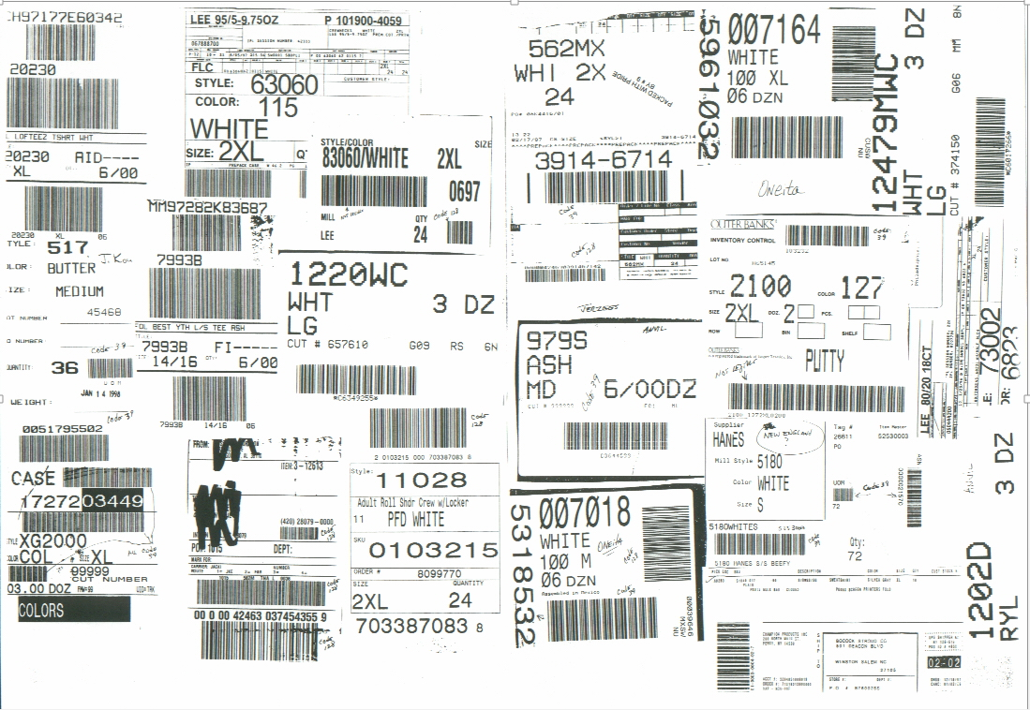
We needed to change something

Slide 6
Timing is everything
Long Beach, CA January 2001
A small wholesaler/manufacturer group discusses standardization and decides it’s time to try
Agreed to contact respective trading partners and invite them to a meeting
Decided that an effort would be most likely to succeed with a “neutral” and experienced consultant
Agreed to meet the following month and agreed to the meeting objectives
Meeting Objectives
To determine if standards in this industry make sense and if there is a critical mass to support the effort
To create a standards organization and a process
To agree on the priorities
To set the cost
And to sign-up participants!

Slide 7
And the timing was right!
The Founders Meeting Tampa, FL - February 2001
Who showed up?
8 manufacturers
6 wholesalers
1 consultant
1 lawyer
ALL SUPPORTED THE EFFORT!
THE ORGANIZATION (TO BE NAMED LATER) WAS LAUNCHED!
The Organization
Tampa meeting attendees (mostly executives representing the wholesalers and manufacturers) would become the Steering Committee
Each Steering Committee member would name staff to serve on the Technical Committee
The Technical Committee would develop standards and make recommendations for Steering Committee approval
In addition to Operations, IT, Marketing and Supply Chain experts from the 16 companies the group partnered with
Uniform Code Council (UCC) that establishes international standards
VICS, (Voluntary Inter-industry Commerce Standards Association)
Quad II, a specialist in bar code technology

Slide 8
The Approach
Keep it simple; stick to basics
Use existing standards and expertise where practical ( UCC, VICS and Quad II)
Assume that this is a first phase
Narrow the focus to those areas with the greatest impact
The group agreed that the movement of product from the manufacturer to the wholesaler offered the greatest opportunity
Consensus of group required to adopt

Slide 9
Kick off meeting - 2001
2 more companies joined the initiative and the group is now 16 companies strong
Consultant moderated the discussion
Manage the agenda
Ensure all attendees have a voice
Preserve meeting neutrality
Referee!
Protect interests of non-participants
Keep us legal
Key decisions and priorities established
Name of the organization will be EASI – Embellished Activewear Standards Initiative
1st priority is to set standards for the exchange of information related to the movement of product from the manufacturer to the distributor

Slide 10
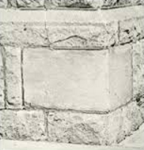
Phase I – 2001 The Cornerstone Standards
Product Identification
Case Labels
Bar Codes
File Specifications

Slide 11
Phase I Cornerstone 1 Product Identification
Global Trade Item Number (GTIN)
The GTIN is an international standard managed by GS1 (www.GS1.org) – similar to the UPC in retail
It is a 14 digit code which includes:
Package indicator
Manufacturer ID
Item Number
Check Digit
The GTIN established a common product identification structure across the industry
MASTER STYLE
Required manufacturers to adopt a single style number per style
Product Descriptor Database ( 832 PDD)
File to serve as the GTIN attribute database and cross-reference
Includes style, color, size, carton dimensions and weight, piece weight, count per carton, and other key attributes
Manufacturer maintains PDD and sends information to the wholesalers
The GTIN, Master Style and PDD were key components to product identification

Slide 12
Phase I Cornerstone 2 Case Label and Phase I Cornerstone 3 Bar Codes
CASE LABEL
Established a consistent mirror image case label with standardized information, dimensions and position on the carton
Improves inbound and outbound shipment accuracy
Reduce shipping/receiving errors and improve error resolution
Bar Codes
GTIN
SSCC-18 (Serialized Shipping Container Code)
Standardized:
Format (UCC 128 Symbology)
Dimensions, position

Slide 13
Phase I Cornerstone 4 File Specifications
File Specifications
ASCII Tab Delimited
Header, Detail, Trailer
A lot of debate vs. XML
Important adoptions
Unit of measure to be “eaches”
Duns number to identify parties
First File - Advanced Shipping Notice (856 ASN)
Produced and forwarded to the wholesaler as shipment leaves the manufacturer
Contains information about the specific contents of each shipment
Eliminate the need to search for and re-key packing lists and bills of lading
Reduce data entry errors
Paperless
Reduce labor costs
Process receipts faster, product available to sell sooner

Slide 14
The new group accomplished a lot in 2001!

Slide 15
Phase II 2002 and Phase III (2003)
Phase II
Purchase Order (850)
P.O. Acknowledgement
Invoice (810)
Functional Acknowledgement (997)
Point Of Sale File (852)
Routing Envelope
Phase III
Order Status/Expected Available To Ship Dates (870)
Payment Remittance Advice (820)

Slide 16
2004, 2005 and 2006
More standards
Inventory Status (846)
Direct Ship Purchase Order (940)
1-Z Shipment Confirmation (945)
New Tools
Compliance Test Program (CPT)
EASI website
Time for more change
Late 2006 the group decides to move in a new direction
Steering Committee evaluation of organization, work done by the group and costs associated with consultant
Decision to self govern and significantly reduce cost for membership
Group mostly in maintenance mode

Slide 17
2007 to Present
2007 to 2011
Special Event promotional pricing (Count / Recounts) (889 and 890)
Return Authorization (180)
Return Authorization Response (181)
Many old files cleaned up or new fields added
EASI By-Laws crafted and approved
EASI legally chartered as a 501 C-3 organization – Embellished Activewear Standards Initiative Group, Inc.
2012 to Present
Enhancements to existing files
Retire Drop Ship Confirmation (945)
Inventory Receipt Advice (861)
Product Locator URL Link (PLUL)
Account Statement (821)
Image Library (IMG)
EASI Standards Zip Pack
Introduction to EASI 101

Slide 18
17 Years of EASI Progress
Maybe it always wasn’t so easy but we’ve made a lot of progress
Let’s talk about the EASI ABC’s
Advantages
Benefits
Challenges

Slide 19
The EASI Advantage
Proven 17 year history of successful collaboration to develop & implement standards
Group recognized in trade publications (Impressions, Wearable’s Business & Frontline Solutions)
Tailored to needs of embellished active wear industry
Demonstrated savings for trading partners
Solid support network for members & newcomers
EASI website www.easistandards.com
Document library
Standards library (file mapping & references)
EASI Steering & Technical Committee support
Members supporting members
CTP (Compliance Test Program)
Inexpensive to join

Slide 20
EASI Benefits
Tremendous labor savings
Data entry labor (PO’s, ASN’s, Invoices…)
IT resources (minimize custom programming)
Centralized functions in many areas
Warehouse labor
Less research due to fewer errors
Significant improvement in accuracy
Reduction in data entry errors
Nearly eliminated file & receipt discrepancies
Inventory integrity
Common terminology for trading partners
Benefits bring new opportunities
IT resources are focused on new development versus frequent customization for trading partners
Enhancements to systems are designed around the EASI standards
New processes are developed taking advantage of EASI which leads to even more gains in productivity and efficiency
The benefits gained are so recognizable that we have been encouraged to find other opportunities

Slide 21
EASI Challenges
Resistance to change
Getting more mills and distributors involved
Getting started with new EASI partners
Helping employees understand what goes on behind the scenes
Feedback regarding non-compliance
Maintain interest and energy for members and potential members
Recruiting volunteers to serve on the Steering and Technical Committee

Slide 22
A Wholesalers Perspective

Slide 23
Inbound Cartons
2000
No standard label
~ 50% had a bar code label but each mill had their own label
1 mill w/unique carton numbers
Very limited ability to scan
What was scanned required customization in order to scan
Most cartons were relabeled
Label errors
Today
EASI standard label
Major suppliers use GTIN, SSCC18 & standard format
Many Exclusive & Private Label vendors are compliant
Unique carton ID (SSCC18)
Scan at receipt
Often used in DC operation
Reconcile as received
Minimal cartons are relabeled
Labor and cost reduction

Slide 24
PO’s, ASN’s and Invoices
2000
Most PO’s & ASN’s were hand keyed & faxed
Invoices were mailed & manually matched & reconciled
The few electronic ASN’s & PO’s were customized
Data entry staff & data entry errors
Daily communication
Between wholesalers & mills
Between A/P, Purchasing & DC personnel
Today
PO’s, ASN’s & Invoices are electronically transmitted, including direct ship
Files for Promotional Pricing, Return Authorizations, Account Statements & Inventory Receipt Advice
No customized files
Reduced data entry = minimal data errors
Exception based processing
Minimal communication to resolve questions, confirm receipt of documents
EASI website with all standards, resource links & user support materials

Slide 25
Receipt processing, posting and AP
2000
Excess handling of cartons
Labeling
Sort (& re-sort) for put away
Receipts held before posting
Reconcile variances
Often 2 days from receipt to posting inventory
Daily communication between A/P , Purchasing , DC’s & mills regarding receipt/PO/invoice variances
Today
Significantly less carton handling
No relabeling
Put away planned before receipt
Cross dock
Put away as truck unloaded
Post within hours of receipt so inventory is available sooner
SSCC18 reconciles ASN/PO as each carton is scanned
Invoice variances electronically captured & significantly reduced

Slide 26
Challenges with non EASI suppliers
Paperwork
Chasing packing lists
Faxing or e-mailing PO’s, packing lists & invoices
Discrepancies between packing list v. PO v. invoice
4 times as many hours spent on ASN’s for those that are not EASI compliant
2 times as long to unload, label and put away non-EASI vendor receipts
If non EASI vendor does have a bar code on label
Create cross reference to read bar code
May need to reconfigure scanning equipment for non-standard symbology
To sum it up… It’s EASIer to do business with suppliers who use the EASI standards

Slide 27
EASI and Your Role
Participate in EASI meetings
Ask questions
Be heard
Develop a plan
Get started to become compliant
Continue to build on your plan
Make use of the EASI web site
Reference materials
Support links to EASI Technical Committee
CPT
Network with other members

