Slide 1
2015 Meeting
Welcome to San Diego!

Slide 2
2015 Annual Meeting
Secretary/Treasurer’s Report
--------
Anti-Trust Guidelines Review
-------
Steering Committee Members & Ballot
April 27, 2015
Nick Freitag, Secretary/Treasurer
treasurer@easistandards.com

Slide 3
Antitrust Guidelines Review
It is the policy EASI and all attendees to comply fully with the antitrust and trade regulation laws of the United States Federal Government and of the various states. This meeting will operate to ensure compliance with the antitrust laws.
ANTITRUST GUIDELINES
The Antitrust laws prohibit agreements or understandings between two or more individuals or businesses to regulate prices or quantities of goods or services, to allocate customers or territories, to hinder or limit a competitor or potential competitor’s operations, or otherwise unreasonably to restrain business activity. Discriminatory pricing or servicing is also prohibited.
Ignoring these laws can be costly and dangerous. Violation of the Sherman Act is a felony: convicted individuals can be and have been imprisoned for up to three years; corporations are subject to heavy fines. Violators may also have substantial judgements for money damages entered against them. Every individual should, therefore, follow these rules:
DO NOT discuss your prices or competitors’ prices with a competitor (except when buying from or selling to that competitor) or anything which might affect prices such as cost, discounts, terms of sale, or profit margins.
DO NOT agree with competitors to uniform terms of sale, warranties, or contract provisions.
DO NOT agree with competitors to divide customers or territories.
DO NOT act jointly with one or more competitors to put another competitor at a disadvantage.
DO NOT try to prevent your supplier from selling to your competitor.
DO NOT discuss your future pricing, marketing, or policy plans with competitors.
DO NOT discuss your customers with your competitors.

Slide 5
NICK FREITAG
EASI TREASURER

Slide 8
Technical Committee Presentation

Slide 9
Agenda/ Discussion Items
Web site Enhancements
New Standard – Image File
Color code enhancement to PDD
Drop-ship returns
Develop an “Open Invoice Summary” or “Account Statement” report/statement by invoice #
Propose the 810 format
850/940 and 856 Consolidation
Discussion Items

Slide 10
Web Site Enhancements

Slide 11
Photo Library v1.0
EASI IMG

Slide 12
Photo Library v1.0 – EASI IMG Header Section

Slide 13
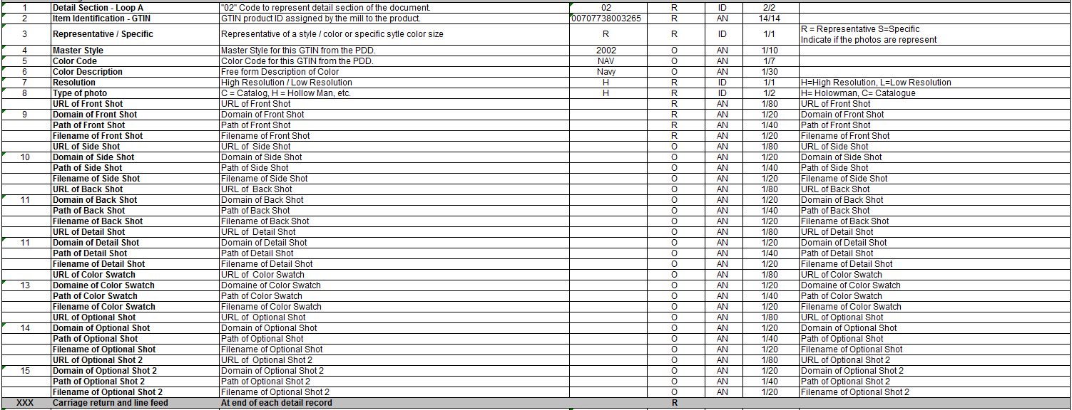
Photo Library v1.0 – EASI IMG Detail Section

Slide 14
Photo Library v1.0 – EASI IMG Trailer Record

Slide 15
Proposal : Add returns to the 852
Issue:
Handling drop ship returns to the distributor’s warehouse
Proposal:
To revise the current EASI 852 (POS) document to capture ALL returns to the warehouse.
This column will capture all of the returns to the warehouse at a sku level (detail line).
Data should be reported as a positive value.
The quantity sold to be updated to report total sales instead of net sales as indicated in the previous version.
Objective:
To provide a comprehensive way of reporting all returns to the warehouse (Distributor)
To provide clear visibility of returns to the Distributor

Slide 16
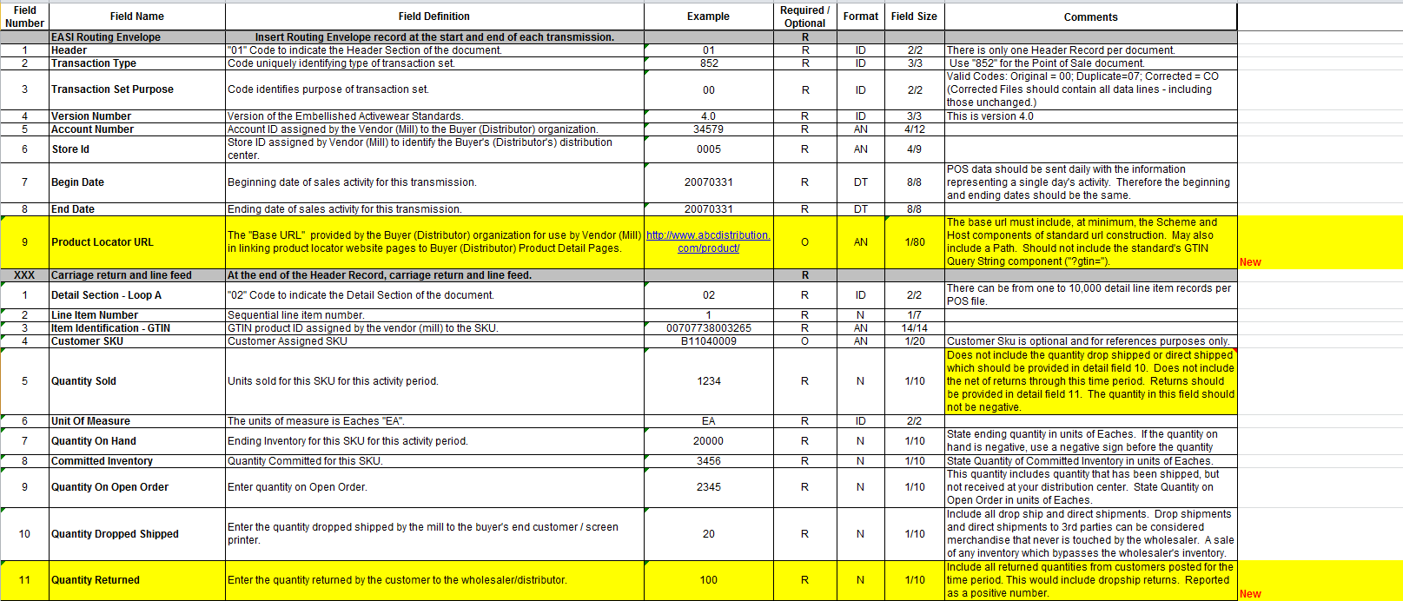

Slide 17
EASI Technical Committee Presentations
846 Proposed Change

Slide 18
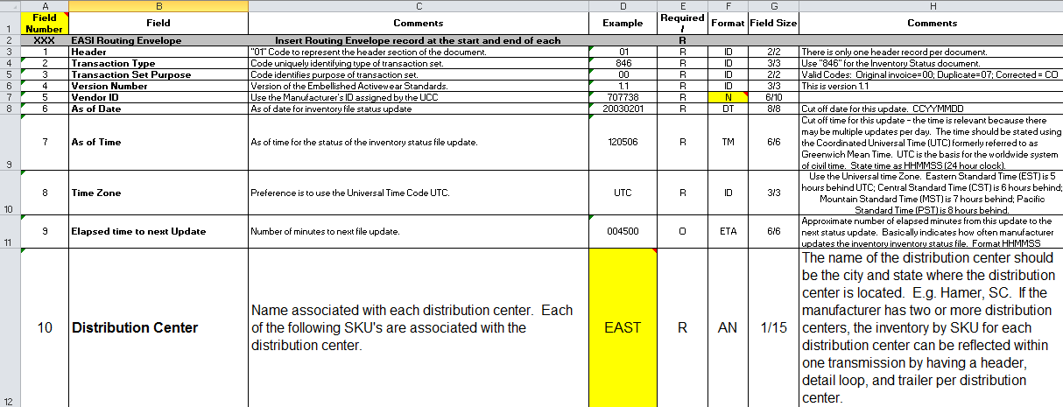
846 Proposed Change
Current Layout
Existing layout uses a distribution center name i.e. city, state, to identify the appropriate warehouse.

Slide 19
846 Proposed Change
Concerns with this data
This convention requires exact naming of warehouse locations between the mill and the distributor
Typically the distributor will have the mill’s warehouse locations setup in their ERP system in order to store the mills inventory quantities and sell them via drop ships.
Use of a name instead of a code that can be translated can cause integration issue at time of setup or when changes occur for either the mill or the distributor.

Slide 20
846 Proposed Change
Example Setup
Distributor warehouse “LA” represents Mill’s “CA” warehouse
940 file uses store id:
Distributor Warehouse “LA” resolves to Mill Warehouse “CA”
846 file uses distribution center:
Distributor Warehouse “LA” resolves to “Los Angeles, CA” description for Mill’s Distribution Center instead of matching by code “CA”

Slide 21
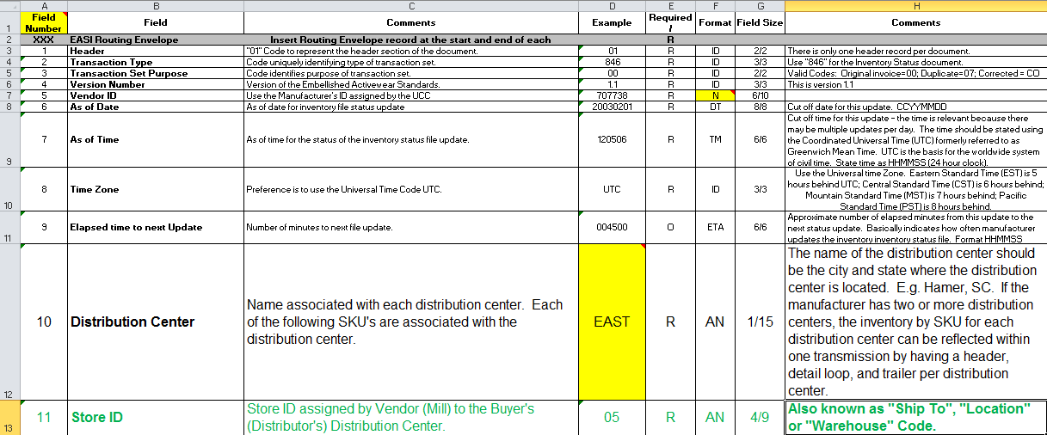
846 Proposed Change
Proposed Change – Use Store Id
The 940 document uses the store id to identify the location
We recommend that the store id also be added to the 846 file and used in the same manner

Slide 22
846 Proposed Change
Benefits
Using the store id instead of a location description will ensure consistency with the 940
It will also allow for a cross-reference by using a code value that can be defined on the setup of the document to refer to the appropriate warehouse
Question
Should the existing “Distribution Center” field be removed to be replaced by the store id instead of just adding the store id?

Slide 23
EASI Technical Committee Presentations
810 Proposed Change

Slide 24
810 Proposed Change
Current Layout
Existing layout assumes that the invoice represents one shipment and one purchase order – see fields 14 and 15 that are required.

Slide 25
810 Proposed Change
Concerns with this assumption
Some mills provide consolidated invoices
Multiple shipments to the same customer within a specific time frame are invoiced together
This is common practice with drop ships where there could be dozens of shipments per day for the same customer
The current layout does not allow these types of invoices to be transmitted using the EASI standard

Slide 26
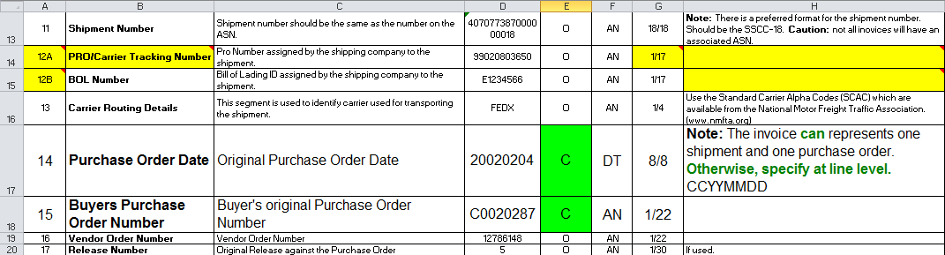
810 Proposed Change
Proposed Change - Header
Change the existing two fields to be Optional instead of Required
Update note to indicate that it can be at the header level or line level

Slide 27
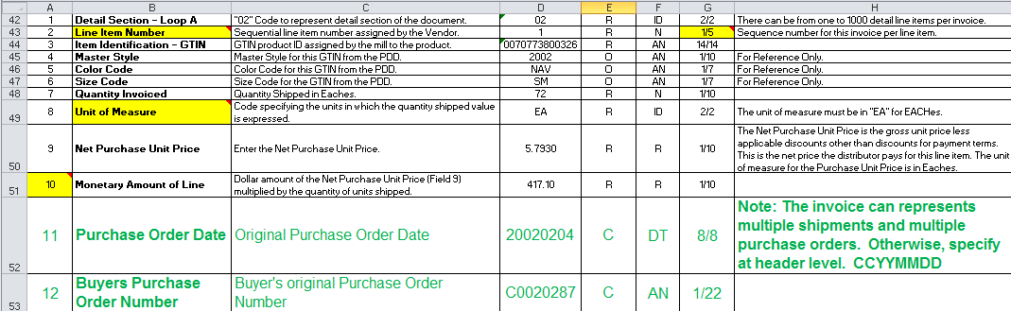
810 Proposed Change
Proposed Change – Lines
Add the Purchase Order Date and the Purchase Order Number to the lines section to allow multiple to be specified for a single invoice.

Slide 28
810 Proposed Change
Related Logic
When sending 810’s for invoices related to multiple customer orders, PO info would need to be provided at line level.
When processing an 810, if PO info is not provided at line level, then use header level PO info to identify which lines are being billed.
Existing validation on PO number/date would need to be changed and additional validation for new line level fields would be required.

Slide 29
810 Proposed Change
Benefits
Using Consolidating Invoicing reduced the volume of A/R transactions for the Mill and the volume of A/P transactions for the Distributor.
This proposed change will allow Consolidated invoices to be sent by the mill and processed by the distributor thereby reducing manual AP entry for the Distributor and related errors.

Slide 30
EASI Technical Committee Presentations
821 Reconciliation

Slide 31
821 Reconciliation
How can we use the 821 Statement of Account?
The 821 document provides a snapshot of open customer invoices from the mill.
These could be compared to open vendor invoices for the distributor.
Any discrepancies in open balances could then be identified systematically.
These could include missed invoices or possible misapplication of credits.

Slide 32
821 Reconciliation
Key Fields for Reconciliation
Statement Date – Date statement was issued
Document Number - Invoice Number / Debit Note Number / Credit Note Number
Document Date – Invoice / Debit Note / Credit Note Date
Original Amount – Original document amount
Balance – Open balance on this document

Slide 33
821 Reconciliation
How do we do it?
The distributor system will receive an 821 document from the mill. The statement date and the appropriate detail information will be required to compare to.
Logic is required to produce Aged Payables details as of the statement date. This will ensure that the comparison is as close as possible.
Using the vendor invoice number, the A/R detail from the 821 file will be compared to the Aged Payables detail on the distributor system.
May also want to match by invoice date and amount as secondary check due to possible errors in vendor invoice number during manual AP entry.

Slide 34
821 Reconciliation
What could we find?
Open A/R but closed A/P
Open A/R but no equivalent A/P in date range
Open A/R but no equivalent A/P exists
Currently in Sync
Original Amount Mismatch
Open Balance Mismatch
Open A/P but no equivalent A/R

Slide 35
821 Reconciliation
Additional Logic
If only Open A/R is reported then additional checks can be implemented to provide additional information.
All payables (open & closed) could be searched to find the related vendor invoice on the distributor system.
If one is found, then original amount, payments and date information can be compared to determine what the issue might be.

Slide 36
821 Reconciliation
Open A/R Issues
When an Open A/R is included in the 821 document but there’s no Open A/P as of the given statement date there could be several reasons:
It could already be paid in the distributor system and possibly the payment hasn’t been received or processed yet by the mill.
It could already be paid in the distributor system but the payment was applied differently by the vendor leaving an open balance.
If already paid, it could have been shorted on entry, leaving an open balance on the mill side. The original amounts can be compared.

Slide 37
821 Reconciliation
Open A/R Issues (Continued)
It could have been entered late and not included in the Aged Payables for the given statement date.
It’s possible it hasn’t been entered at all yet in the distributor system.

Slide 38
821 Reconciliation
Match Issues
When an Open A/R and the related Open A/P are found there could be multiple scenarios:
Best case: original amount, payment amount and current balance all match – no issue.
Original amounts could differ. This could be due to discrepancies with the received shipment resulting in a short-pay on the invoice.
Original amounts may match but current balance differs. This could be due to different application of payments between the distributor and the mill.

Slide 39
821 Reconciliation
Open A/P Issues
When an Open A/P exists but there isn’t a related document in the 821 document, there could be multiple scenarios:
Since we don’t have additional information on the A/R side, we cannot determine if the related A/R invoice already exists and is already paid.
It’s possible that it did exist but due to a difference in how invoices were paid off, it has been paid off in error in the mill’s system.
If it’s a debit memo, it could be related to an inventory return that has been sent to the vendor and not yet processed or approved.

Slide 40
821 Reconciliation
Benefits
By using the proposed 821 document, we could implement a process to systematically compare the mill’s open AR to the distributor’s open AP. This process already occurs manually or using spreadsheets when needed. It could be simplified by using this process that will identify the discrepancies that require further investigation.
If used and monitored regularly, it would assist both the mill’s AR department and the Distributors AP department with ensuring that the information stays in synch.

Slide 41
Proposal : 850/940 and 856/945 consolidation
The objective is to merge the 850/940 and the 856/945 standards into two standards

Slide 42
Proposed 850/940 Consolidation
Field Number | Field Name | Field Definition | Example | Required / Optional | Format | Field Size | Comments
XXX | EASI Routing Envelope | Insert Routing Envelope record at the start and end of each transmission. |  | R
1 | Header | "01" Code to represent the header section of the document. | 01 | R | ID | 2/2 | There is only one header record per purchase order transaction.
2 | Transaction Type | Code uniquely identifying type of transaction set. | 850 | R | ID | 3/3 | Use "850" for the Purchase Order document.
3 | Transaction Set Purpose | Code Identifies purpose of transaction set. | 00 | R | ID | 2/2 | Valid Codes: Original=00, Duplicate=07, Proposed=16, 22= Information Copy.
4 | Version Number | Version of the Embellished Activewear Standards. | 1.0 | R | AN | 3/3 | This is version 1.0
5 | Purchase Order Type Code | Code specifying the type of Purchase Order. | SA | R | ID | 2/2 | Valid Codes: Stand Alone Order = SA, Blanket Order (Quantity Firm) = BK, Release or Delivery Order (Used in conjunction with a Blanket Order) = RL.
6 | Purchase Order Number | Identifying number for the Purchase Order assigned by the Purchaser (Buyer/Distributor). | C0020287 | R | AN | 1/22
7 | Release Number | Number identifying a release against a Purchase Order previously placed by the Purchaser (Buyer/Distributor). | 10 | O | AN | 1/30
8 | PO Date | Original purchase order date. | 20020207 | R | DT | 8/8 | CCYYMMDD. This is not necessarily the date the PO is transmitted.
9 | PO Time | PO Creation Time. | 122325 | O | TM | 6/6 | HHMMSS assumes a 24 hour clock - UTC
10 | Contract Number | Contract Number | A123456 | O | AN | 1/30
11 | Currency Code | Code for country in whose currency the charges are specified. | USD | R | ID | 3/3 | (ISO 4217 Currency Symbol List www.xe.com/iso4217.htm) United States of America, Dollars = USD; Canada, Dollars = CAD; Euro Member Countries, Euro = EUR.
12 | Purchaser Account ID | Account ID assigned by the vendor (mill) to the buyer's (distributor) organization. | 34579 | R | AN | 4/12
13 | Store ID | Store ID assigned by Vendor (Mill) to the Buyer's (Distributor's) Distribution Center. | 0005 | R | AN | 4/9 | Also known as "Ship To", "Location" or "Warehouse" Code.
14 | Vendor ID | Use the Vendor's Manufacturer ID assigned by the UCC. | 707738 | R | AN | 6/10
15 | Contact Name/Number | From Buyer's organization the Purchasing Agent's Name and Phone Number | John Doe 314-999-1279 | O | AN | 1/45 | Free form name for contact person - include area code and phone number in the field.
16 | FOB Payment Instructions | FOB Shipment Method of Payment | PP | R | ID | 2/2 | Valid codes: Prepaid by Seller = PP, Paid by Buyer, billed by Carrier = CC.
17 | Sales Requirement Code - Shipment | Code to designate Buyer's completeness requirements in relation to this Purchase Order. | BK | R | ID | 2/2 | Valid Codes: Order can be shipped partial with the balance back ordered = BK, Order can be shipped partial and the balance should be cancelled = SP, Order can only be shipped complete = SC.
18 | Sales Requirement Code - Truck Load | Code to designate Buyer's Truck Load Requirements for this Purchase Order. | FT | O | ID | 2/2 | Valid Codes: Ship as (part of) a full truck load only = FT, or less than a full truck load if necessary = LT.
19 | Sales Requirement Code - Ship Date | Code to designate Buyer's immediacy requirements in relation to the Purchase Order's Ship Date. | P2 | O | ID | 2/2 | Valid Codes: Ship as soon as possible = P2, Do not pre-ship = P4, or Vendor can pre-ship with prior approval of the buyer = P3.
20 | Sales Requirement Code Consignment / or Ship Blind | Code to designate the Buyer's requirement for shipment of the Purchase Order as consignment or blind shipment. | SB | O | ID | 2/2 | Ship Blind normally pertains to drop shipments where the Buyer wants the goods to be shipped to a third party, but does not want the third party to know the merchandise came from the Vendor (Mill). Valid Codes: This is a consignment order = CS, ; The Vendor (mill) is to ship blind = SB, Other = Leave Blank.
21 | Payment Terms - Discount Offered | Percentage discount off the Invoice if paid on or before a specified number of days (Field 22 Payment Terms - Discount Days) from invoice date. | 2.25 | O | N | 1/4 | The discount percentage amount must be expressed as a percentage. The decimal point must be shown when the percentage is not a whole number. (Example: 2.5% shown as 2.5. 2.0% may be shown as 2.)
22 | Payment Terms - Discount Days | Number of days from the invoice date the Buyer (Distributor) can take a discount if paid on or before. | 10 | O | N | 1/3
23 | Payment due in number of days without discount | Payment is due in this number of days (without a discount). | 30 | O | N | 1/3 | Example: 30 days, 180 days. Note: Either this field (Payment due in number of days) or Specific Payment Date must be entered.
24 | Specific Payment Date | For some special orders there may be an agreed upon date (specific) when payment is due. If this is the case, use this field. | 20021231 | O | DT | 8/8 | CCYYMMDD. Note: Either this field Specific Payment Date or Payment Due in number of days without a discount (Field 23) must be entered.
25 | Literal of Payment terms | Literal stating Payment Terms | pay balance due in three equal monthly amounts | O | AN | 1/45 | (Example: 2%, 10 days, net 30) Can also be used for special situations. This is a human readable field, not a machine readable field. This field should only be used on an exception basis when the other fields do not correctly describe the payment terms.

Slide 43
Proposed 850/940 Consolidation (cont)
26 | Requested Ship Date | Requested Ship Date for the shipment to leave the Mills Distribution Center. | 20020225 | O | DT | 8/8 | CCYYMMDD.
27 | Cancel Date | Date to cancel order for any items that have not been shipped to the Buyer (Distributor). | 20020331 | O | DT | 8/8 | CCYYMMDD.
28 | Carrier Routing Details | This segment is used to identify carrier used for transporting the shipment. | FEDX | O | ID | 1/4 | Use the Standard Carrier Alpha Codes (SCAC) which are available from the National Motor Freight Traffic Association. (www.nmfta.org)
29 | Deliver to Company Name | For standard delivery to Buyer's (Distributor's) Distribution Center, enter the name of the Distribution Denter. | Alpha Philadelphia Distribution Center | C | AN | 1/45 | For a drop ship, enter the company name. | required if drop ship code field number 37 is a Y
30 | Deliver to - Contact Name | Deliver to Contact name | John Smith | O | AN | 1/30
31 | Deliver to Address 1 | Address line 1 |  | C | AN | 1/30 |  | required if drop ship code field number 37 is a Y
32 | Deliver to Address 2 | Address line 2 |  | O | AN | 1/30 | If Required.
33 | Deliver to City Name | City Name |  | C | AN | 1/30 |  | required if drop ship code field number 37 is a Y
34 | Deliver to State Code | State Code |  | C | AN | 2/2 |  | required if drop ship code field number 37 is a Y
35 | Deliver to Postal Code | Postal Code |  | C | AN | 1/11 |  | required if drop ship code field number 37 is a Y
36 | Deliver to Country Code | Country Code |  | O | ID | 2/2 | Two Digit ISO 3166-1 Alpha-2 Country code.
37 | Drop Ship Code | Code to indicate whether shipment will be drop shipped or delivered to buyers warehouse | N | R | ID | 1/1 | Valid Codes: "Y" = Drop Ship, "N" = Deliver to Buyer's Warehouse.
38 | Special delivery instructions | Free form field for any special delivery instructions. | Deliver to Receiving Dock before 8:00 AM, call before delivery | O | AN | 1/90 | Normally only used for drop ship orders.
39 | Special order instructions | Free form field for any special order instructions. | Shrink Wrap cartons | O | AN | 1/90 | Normally only used for drop ship orders
40 | Deliver To County/Province /Town/Territory | Code used to identify Counties ( For UK, AUS, CAN etc) | UKK | O | AN | 1/30
41 | Promotional Code | Code used to Identify special promotions on the Purchase Order | PROMO001 | O | AN | 1/20
42 | Delivery - Service Level | Carrier specific service delivery code. Use the UPS service delivery code as a default for another carrier. (see References tab). | 92 | C | ID | 2/15 | Revised 7/18/06 See attached list of codes and options for UPS and FedEx. Example 92 - Fed Ex Standard Ground. Please note - the code must be formated as a text field and not a numeric field. Some of the codes have a leading zero that can not be ignored. 01 is different than 001 or 1. You will note that some of FedEx and UPS codes are the same but they mean something different in terms of the service / delivery option. Use the UPS service delivery code as a default for another carrier. (see References tab). | required if drop ship code field number 37 is a Y
43 | Deliver to - Receivers Phone number | Receiver's phone number. | 212-345-678 | O | AN | 1/20 | Enter contact phone number at the receiving company.
44 | Customer PO Number | ID assigned by the customer who placed this order with the Wholesaler. | A123456 | O | AN | 1/30 |  |  | new line
45 | COD for Merchandise | Instructions for COD Shipment of the Purchase Order. | Y1 | C | ID | 2/3 | Valid Codes: Code Y1 - if the merchandise is to be paid for COD by certified check, money order, etc. Code Y2 for all other payments including business checks; code the transaction with N if it will not be COD. If you indicate Y1 or Y2 - there must be a dollar amount on the trailer record for the shipper to collect. | required if drop ship code field number 37 is a Y | new line
46 | Receivers Email Address | The Receiver's email address. | abc@onecompany.com | O | AN | 5/50 | Enter email address for receiving company. Will use email address to send confirmation of shipment to the receiving company. |  | new line
47 | Account number | Common Carrier Account Number to be charged for freight. | 107952 | C | AN | 1/20 | This is a required field. This field should always be the wholesaler's account number. | required if drop ship code field number 37 is a Y | new line
48 | Name of Account | Name of account to be charged for freight | Company XYZ | C | AN | 1/45 | This is a required field. The field is required if the wholesaler's customer will pay the freight charges or the wholesaler pays the freight. Enter the name of the company to be charged the freight charges. | required if drop ship code field number 37 is a Y | new line
49 | Tracking ID | Tracking ID created by wholesaler for this order. | 7845-081604 | O | AN | 1/45 | Display the tracking ID on the confirmation email |  | new line
50 | Purchaser's account ID | Account ID number assigned by Wholesaler to the recipient. | A123456789 | O | AN | 1/45 | Enter the Wholesaler's ID for this account. Will be printed on packing slip. |  | new line

Slide 44
Proposed 850/940 Consolidation (cont)
51 | Deliver to Commercial or Residential Site | Code used to indicate delivery to commercial or residential site. | 0 | C | ID | 1/1 | Valid Codes: Use the code "0" when the delivery will be to an urban / Commercial location; Use the code "2" when the delivery will be to an Urban / Residential location; Use the code "4" when the delivery will be to a Rural / Commercial location; Use the code "6" when the delivery will be to a Rural / Residential location. (Pleae note that each freight carrier has its own designation of which zip codes are considered Rural versus Urban. See list from the specific freight carrier that you are using to determine the correct code.) (Please note that the previous codes of "C" and R" are no longer valid.) | required if drop ship code field number 37 is a Y | new line
52 | COD Tags Indicator | Code used to Indicate how the shipping cartons will be tagged for shipment . | M | C | ID | 1/1 | Valid Codes: Multiple tags (M), One tag (O), no tags (N) | required if drop ship code field number 37 is a Y | new line
53 | 3rd Party Account Number | 3rd Party account number to be charged for freight | 345774 | O | AN | 1/20 | This is an optional field. If the order is a 3rd party order, where the wholesaler's customer will pay the freight charges, enter the account number to be charged for freight. This field will override field 34 Account Number. |  | new line
XXX | Carriage return and line feed | At end of the header record |  | R
1 | Detail Section - Loop A | "02" Code to represent detail section of the document. | 02 | R | ID | 2/2 | There can be from 1 to 9999 detail line items per purchase order.
2 | Line Item Number | Sequential line item number assigned by the buyer (Distributor). | 1 | R | N | 1/4
3 | Item Identification - GTIN | GTIN product ID assigned by the mill to the product. | 00707738003265 | R | AN | 14/14
4 | Master Style | Master Style for this GTIN from the PDD. | 2002 | O | AN | 1/10 | For Reference Only.
5 | Color Code | Color Code for this GTIN from the PDD. | NAV | O | AN | 1/7 | For Reference Only.
6 | Size Code | Size Code for the GTIN from the PDD. | SM | O | AN | 1/7 | For Reference Only.
7 | Quantity Ordered | Quantity Ordered in Eaches. | 72 | R | N | 1/10
8 | Unit or Basis for Measurement Code | Code specifying the units in which the quantity ordered value is expressed. | EA | R | ID | 2/2 | The unit of measure must be in "EA" for EACHes.
9 | Purchase Unit Price | Enter the Purchase Unit Price or Selling Unit Price. | 5.7930 | O | R | 6/10 | For non-drop ship orders: The Purchase Unit Price is stated after discounts and before payment terms discounts. This is the price the Distributor expects to pay for this item. The Purchase Unit Price should be stated to four decimal places. Leave this field blank if you do not know the Purchase Unit Price. The Trading Partner Agreement should spell out the rules for the Purchase Unit Price field. For drop ship orders: The Selling Unit Price is stated after discounts and before payment terms discounts. This is the price the purchaser pays to the wholesaler for this line item. The Selling Unit Price should be stated to two decimal places. Leave this field blank if you do not want it printed on the packing slip / invoice. Note: For 3rd Party Direct Shipments - the price entered in this field is the invoice price. It is the price that will be charged to the purchaser.
10 | Total monetary amount of line item | Dollar amount of the units multiplied by the quantity of units on order. | 417.1000 | O | R | 6/10 | Leave blank if the Purchase Unit Price Field is blank.
XXX | Carriage return and line feed | At end of each detail record |  | R

Slide 45
Proposed 850/940 Consolidation (cont)
1 | Other Charges Record | "06" Code to indicate start of the record to show charges and discounts that are not directly related to the individual SKUs. | 06 | C | ID | 2/2 | The Other Charges and Discounts record is optional. You must have an Other Charges Record if there will be other charges and discounts, otherwise, skip this record. For example a $1000 discount for placing the order.
2 | Line Item Number for Other Charges | Sequential line item number assigned by the Buyer (Distributor). | 1 | C | N | 1/2 | There may be multiple line items, one for each special charge or discount.
3 | Other Charge Description | Free form description for the Other Special Charges or Discounts. | Discount on order | C | AN | 1/45
4 | Other Charge Amount | Other charges value. | -1000.0000 | C | R | 6/10 | A dollar increase is stated as a positive number, a reduction to the total invoice amount is shown as a negative number.
XXX | Carriage return and line feed | At end of the Other Charges Record |  | C
1 | Trailer Record | "09" Code to indicate start of the Trailer Record of the Document. | 09 | R | ID | 2/2 | There is only one Summary record per purchase order.
2 | Record count | The total of all records transmitted. | 3 | R | N | 1/7 | The record count is computed as the number of line items in the detail section of the PO, the number of line items in the other charges section plus two for the header and the summary records. This field will be used as a reasonableness check to make sure the receiver has all the records.
3 | Total quantity ordered | Compute the total quantity ordered based on the sum of all the items ordered in the detail section of the purchase order. | 72 | R | N | 1/10 | Total of all quantities in Field Number 7 of the detail section. The quantity must be in units of Eaches. The total quantity ordered field will be used as a second check to verify that the receiver has correctly read all the detail records in the purchase order.
4 | Total Monetary Value | Total dollar amount of the purchase order before other charges. | 8340.0000 | O | R | 6/14 | For non-drop ship orders: enter total dollar amount of the purchase order before other charges. For drop ship orders: enter the amount to be invoiced to the purchasing company. This is the amount the common carrier needs to collect for a COD order. Leave this field blank if you do not want the dollar amount to appear on the packing slip.
5 | Total Monetary Value of Other Charges | Total dollar amount of the Other Charges. | -1000.0000 | O | R | 6/14
6 | Number of Cases | Enter the estimated number of shipping cases in this shipment. | 5 | O | N | 1/7
7 | Purchase Order Total Amount | Total purchase order amount equal to the total dollar amount plus taxes less discounts. | 7340.0000 | O | R | 6/14
XXX | Carriage return and line feed | At end of the trailer record |  | R

Slide 46
Proposed 856/945 Consolidation
Field Number | Field Name | Definition | Example | Required / Optional | Format | Field Size | Comments
XXX | EASI Routing Envelope | Insert Routing Envelope record at the start and end of each transmission |  | R
1 | Header | "01" Code to represent the header section of the ASN Document. | 01 | R | ID | 2/2 | There is only one header record per asn transaction.
2 | Transaction Type | Code uniquely identifying type of transaction set. | 856 | R | ID | 3/3 | Use "856" for the ASN document.
3 | Transaction Set Purpose | Code Identifies purpose of transaction Set, Original=00, Retransmit=01 | 00 | R | N | 2/2 | Valid Codes: Original=00, Duplicate=07, Proposed=16, 22= Information Copy.
4 | Version Number | Version of the Embellished Activewear Standards. | 6.0 | R | ID | 3/3 | This is version 6.0 | determine version number
5 | Drop Ship Code | Code to indicate whether shipment will be drop shipped or delivered to buyers warehouse | N | R | ID | 1/1 | Valid Codes: "Y" = Drop Ship, "N" = Deliver to Buyer's Warehouse. | new row
6 | Shipment Number | ASN Shipment Identification Assigned by Shipper (SSCC-18) | 407077387000000018 | C | AN | 1/18 | SSCC-18 Unique Tracking Number for Shipment. Required if Drop Ship Code is a "N".
7 | ASN Date | ASN Creation Date | 20010708 | C | DT | 8/8 | CCYYMMDD, Required if Drop Ship Code is a "N".
8 | ASN Time | ASN Creation Time | 121305 | C | TM | 6/6 | HHMMSS assumes a 24 hour clock - UTC, Required if Drop Ship Code is a "N".
9 | Vendor ID | Use the Vendor's Manufacturer ID assigned by the UCC. | 0707738 | C | AN | 6/10 | Required if Drop Ship Code is a "N".
10 | Purchaser Account ID | Account ID assigned by the vendor (mill) to the buyer's (distributor) organization. | 17820 | C | AN | 4/12 | Required if Drop Ship Code is a "N".
11 | Store ID | Store ID assigned by Vendor (Mill) to the Buyer's (Distributor's) Distribution Center. | 0001 | C | AN | 4/9 | Also known as "Ship To", "Location" or "Warehouse" Code. Required if Drop Ship Code is a "N".
12 | Deliver To Company Name | For standard delivery to distributors distribution center, enter name of distribution center. | Best Shirts | R | AN | 1/45 | For a drop ship, enter the company name.
13 | Deliver to Address 1 | Ship To Company Address Line 1 | 3130 Broadway | R | AN | 1/30
14 | Deliver to Address 2 | Ship To Company Address Line 2 (if required) | Building 2 | O | AN | 1/30
15 | Deliver to City Name | Ship To Company City Name | Anywhere | R | AN | 1/30
16 | Deliver to State Code | Ship To Company State Code | NY | R | AN | 2/2
17 | Deliver to Postal Code | Ship To Company Postal Code | 63000 | R | AN | 1/11
18 | Deliver to Country Code | Ship To Country Code | US | O | ID | 2/2 | Two Digit ISO 3166-1 Alpha-2 Country code.
19 | BOL Number | Bill of Lading ID assigned by the shipping company to the shipment. | 33996 | O | AN | 1/17
20 | Carrier Routing Details | SCAC Carrier Code | FEPL | O | AN | 4/4
21 | Trailer ID | Trailer ID | ABC12345 | O | AN | 2/20
22 | Shipment Date | Date of Shipment (CCYYMMDD) | 20010706 | R | DT | 8/8
XXX | Carriage return and line feed | At end of the header record |  | R
1 | Pallet Record | Pallet Record (Type "05") Optional | 05 | O | ID | 2/2
2 | Pallet ID | Pallet ID (SSCC18) | 107077380000002807 | C | ID | 18/18
XXX | Carriage return and line feed | At end of the Pallet Record header record |  | R
1 | DETAIL Section - Loop A | Detail Record Type (02) | 02 | R | ID | 2/2
2 | Carrier Tracking Number | PRO # or Parcel Tracking Number | 1Z5R9A10341241218 | C | AN | 1/45 | Required if Drop Ship Code is a "Y"
3 | Manufacturer's Serial Case Number | Manufacturer's Serial Case Number (printed on the case label SSCC-18) | 007077380000002800 | R | AN | 1/18 | Also known as Case LPN (License Plate Number). Made up of Packing Type Indicator, UCC Manufacturer's ID, Shipping Container Serial Number and mod 10 check digit.
4 | Purchase Order Type Code | Code specifying the type of Purchase Order | SA | O | ID | 2/2 | Valid Codes: Stand Alone Order = SA, Blanket Order (Quantity Firm) = BK, Release or Delivery Order (Used in conjunction with a Blanket Order) = RL. | new row
5 | Buyers Purchase Order Number | Identifying number for Purchase Order assigned by the Wholesaler to this order | W1044 | R | AN | 1/30
6 | PO Date | Original purchase order date. | 20060601 | R | DT | 8/8 | CCYYMMDD. This is not necessarily the date the PO is transmitted. | new row
7 | PO Time | HHMMSS, assumes a 24 hour clock | 122325 | O | TM | 6/6 | HHMMSS (24 hour clock) | new row
8 | Tracking ID | Tracking ID created by wholesaler for this order. | 7845-081604 | O | AN | 1/45 | Display the tracking ID on the confirmation email. | new row
9 | Manufacturer's Order Number | Manufacturer's Order Number | 1808819 | O | AN | 1/12
10 | Case Weight | Case Weight in pounds | 3.80 | R | N | 4/10 | Weight includes weight of carton and packing material in pounds. | new row
11 | Freight Charge | Freight Charge in US Dollars. | 4.07 | C | N | 4/10 | Required if Drop Ship Code is a "Y" | new row
XXX | Carriage return and line feed | At the end of each loop A detail record. |  | R

Slide 47
Proposed 856/945 Consolidation (cont)
XXX | Begin Loop B | Use Code "B" to indicate the start of the loop B. Use loop B to report the contents on each shipped carton | 03 | C | ID | 1/1 | Loop B is Conditional. Use if the mill reports the items and quantity shipped in each carton, otherwise skip loop B. Not all the mills will be able to report the specific contents of each carton. | New loop B added
1 | Line Item Number | Sequential line item number assigned to the Item by the Wholesaler (Buyer) on the 850 PO. | 1 | C | N | 1/7 | Line Item Number should match line item number on 850 PO Document. If 850 was not received for item line being shipped use Mill's sequential line item number. The maximum size of the field needs to handle more than 35,000 line items.
2 | Item Identification - GTIN | GTIN product ID assigned by the manufacturer to this product | 00707738003265 | R | N | 14/14
3 | Master Style | Master Style for this GTIN from the PDD, for reference only | 2002 | R | AN | 1/10
4 | Detail Style | Manufacturers Detail Style ID | 2002D | O | AN | 1/10
5 | Color Code | Color Code for this GTIN from the PDD, for reference only | NAV | R | AN | 1/7
6 | Size Code | Size Code for the GTIN from the PDD, for reference only | S | R | AN | 1/7
7 | Revision Code | Revision Code | 000 | O | AN | 1/3
8 | Unit or Basis for Measurement Code | Code specifying the units in which the quantity shipped value is expressed. | EA | R | ID | 2/2 | The unit of measure must be in "EA" for EACHes.
9 | Quantity Shipped | Quantity Shipped in Eaches | 36 | R | R | 1/10
10 | Country of Origin | Country of Origin Country Code | HN | R | ID | 2/2
11 | Manufacturer's Lot ID | Manufacturers Lot ID | 346550 | O | AN | 1/12
XXX | Carriage return and line feed | At the end of each loop B detail record. |  | C |  |  |  | New loop B added
1 | Trailer Record | "09" Code used to indicate start of the Trailer Record of the ASN Document. | 09 | R | ID | 2/2 | There is only one Summary Trailer record per ASN.
2 | Total Case Count | Total Case Count on Shipment | 11 | R | N | 1/7 | Total of all Detail lines excluding Pallet Record Lines.
3 | Total Qty Shipped | Total Shipped Qty in Eaches. | 125 | R | N | 1/7 | Sum of all Quantity Shipped Detail lines.
4 | Total Gross Weight | The total gross weight of the shipment. | 256 | R | N | 1/7 | The total weight of all the cartons included in this shipment. Show weight in pounds
5 | Total Freight Charges | The total freight charges for this shipment. | 75.23 | R | N | 4/10 | The total freight charges is the total freight charges for all the cartons included in this shipment. Sum total of all Detail Segment - Loop A Field 17. Show the freight charges in US dollars. | new row
6 | Record Count | The total of all records transmitted. | 14 | R | N | 1/7 | The record count is computed as the number of line items in the detail section of the ASN (inlcuding any pallet record lines) plus two for the header and the trailer records. This field will be used as a reasonableness check to make sure the receiver has all the records.
6 | Total Pallet Count | Total number of pallets | 1 | R | N | 1/7 | Count of "05" Pallet Record Lines.
XXX | Carriage return and line feed | At end of the trailer record |  | R

Slide 48
Discussion Points

Slide 49
Discussion Points
Order Acknowledgement summary
Objective:
to provide a summary of the EASI 850 data that is received from the customer.
does not indicate whether the order will be fulfilled but provides an acknowledgment to the customer that a PO has been received and the quantity per PO.
proposed document name is the EASI 855 v 2.0.
Suggestions:
Generate a list of validations for file to communicate in response
Use proposed standard if there is enough business need and propose a second standard which indicates the error

Slide 50
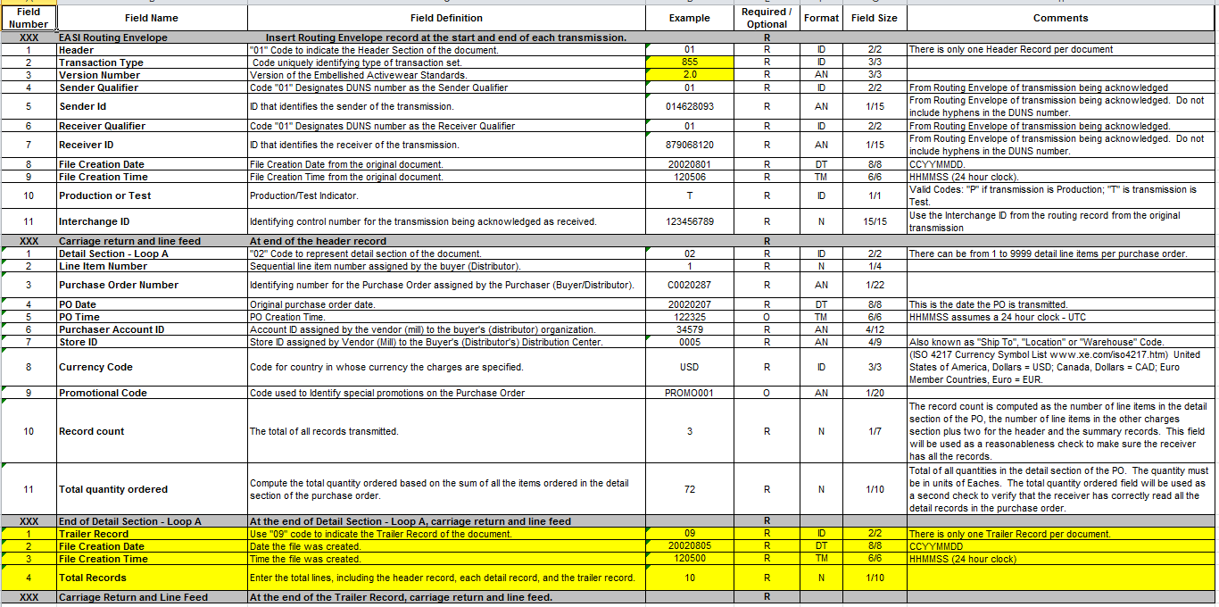
EASI 855 v 2.0 Standard

