Slide 1


Slide 2

EASI Annual Meeting
2023
Welcome to Austin

Slide 3

Agenda
1) Welcome Message – Rob Smith, Executive Chairperson
2) Review Anti-Trust Guidelines, Roll call – Jeremy Wingo, Secretary / Treasurer
3) Approve Minutes from October 7, 2022 Meeting
4) Annual Financial Report – Jeremy Wingo
5) Elections – Rob Smith
6) EASI Bylaws: What and Why? – Debbie Krissinger
7) Technical Committee Discussion – Toni Tarini
a) API Standards Showcase
b) New Standards – 830 Forecast/Planning Schedule
c) Open Discussions
8) Group Discussions
a) Increasing Membership
b) Proposed 2024 EASI Meeting Location

Slide 4



New Members

Slide 5
Antitrust Guidelines Review
It is the policy EASI and all attendees to comply fully with the antitrust and trade regulation laws of the United States Federal Government and of the various states. This meeting will operate to ensure compliance with the antitrust laws.
ANTITRUST GUIDELINES
The Antitrust laws prohibit agreements or understandings between two or more individuals or businesses to regulate prices or quantities of goods or services, to allocate customers or territories, to hinder or limit a competitor or potential competitor’s operations, or otherwise unreasonably to restrain business activity. Discriminatory pricing or servicing is also prohibited.
Ignoring these laws can be costly and dangerous. Violation of the Sherman Act is a felony: convicted individuals can be and have been imprisoned for up to three years; corporations are subject to heavy fines. Violators may also have substantial judgements for money damages entered against them. Every individual should, therefore, follow these rules:
DO NOT discuss your prices or competitors’ prices with a competitor (except when buying from or selling to that competitor) or anything which might affect prices such as cost, discounts, terms of sale, or profit margins.
DO NOT agree with competitors to uniform terms of sale, warranties, or contract provisions.
DO NOT agree with competitors to divide customers or territories.
DO NOT act jointly with one or more competitors to put another competitor at a disadvantage.
DO NOT try to prevent your supplier from selling to your competitor.
DO NOT discuss your future pricing, marketing, or policy plans with competitors.
DO NOT discuss your customers with your competitors.

Slide 6

2022 Minutes of the Meeting
Minutes of the 2022 EASI Annual Meeting
Las Vegas, Nevada
October 7, 2022
Annual Financial Report
Prior to the EASI Annual Meeting, Marvin Yoshizumi and Rob Smith reviewed the
monthly checking account statements and financial reports since the 2021 Annual
Meeting, as documented by the Treasurer, Michael Sutton. Marvin and Rob examined
the records presented and found no irregularities or discrepancies with the accuracy of
the books and reporting. They both signed a document attesting to this fact.
General Session
The Annual EASI Meeting commenced at 10:00am, local time, with a welcoming
statement from the Executive Chairperson, Marvin Yoshizumi. Marvin requested
attendees identify themselves, the company they are representing and if they are the
voting member representing their company.
Meeting attendance as follows:
Company Attendee

Slide 7
Annual Financial Report

Slide 8
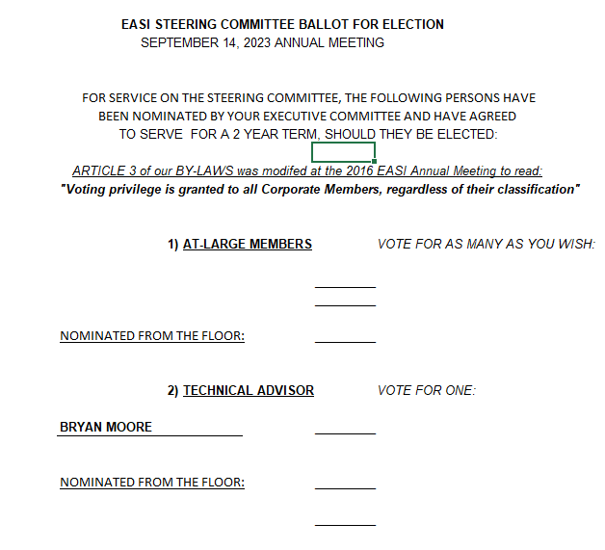
2023 Elections

Slide 9

By-Laws: What and Why?
Name and Affiliation
  The name of this organization shall be the Embellished Activewear Standards Initiative.
  This organization has no other affiliation.
Purpose
  To promote the standardization of common business information, processes and communication in the Embellished Activewear Industry.
  To Act as a forum for addressing business transaction standards between wholesaler, manufacturer and their trading partners in the Embellished Activewear Industry
  To increase efficiencies and reduce errors within the supply chain through the use of prevailing technology.

Slide 10
By-Laws
What are By Laws?
Webster: a rule adopted by an organization chiefly for the government of its members and the regulation of its affairs
Why have By Laws?
Roadmap for running a business or organization
Define governance for things such as board positions & responsibilities, meeting guidelines, dues, membership, voting eligibility, elections, amendments, and dissolution of the organization
Legally binding document; organizations can be challenged in court for violations of bylaws
Where to find the EASI By Laws
Go to the EASI website: www.easistandards.com
Use the Support tab, go to Docs and Guidelines where you will find a link to the EASI By Laws: EASI Standards Group | Documents and Resources
Select EASI Group By-Laws
Last updated in 2020

Slide 11
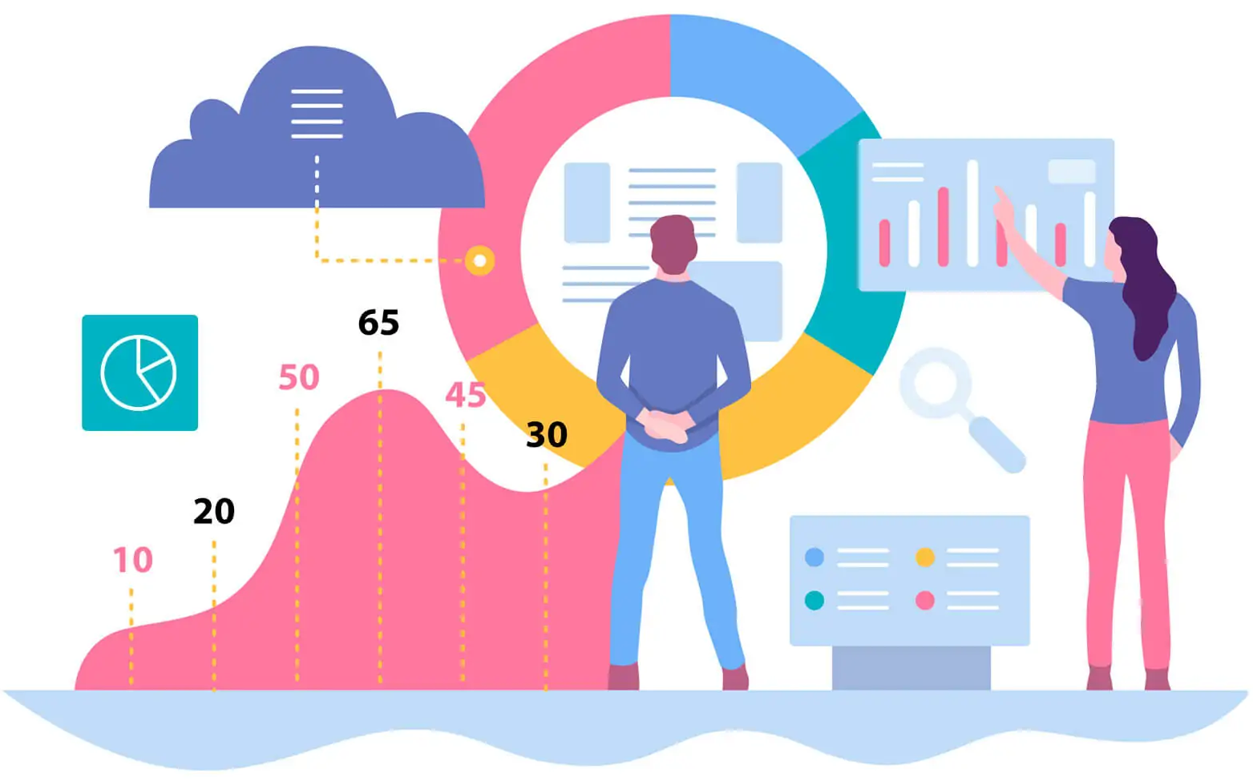
EASI Website
We upgraded to GA4 in July
160 Avg Visitors per Month
600 Avg Pageviews per Month

Slide 12

EASI Website
Top Pages
/standards
/annual-meetings
/850-po
/2023-meeting
/856-asn
/940-dropship
/870-order-status
/members
/832-pdd
/846-inventory-status

Slide 13

EASI Website
We configured DKIM Authentication, which improved deliverability from 90% to 95%.
We did some spring cleaning of our subscriber list.
Even with the removals we increased subscribers from 133 to 141.
We responded to 5 questions received through the site since the last meeting.

Slide 14


Slide 15


2023 Technical Committee Presentation

Slide 16




Agenda
API Standards Showcase
830 Proposal
Open Discussions
Notes:
Today’s agenda will cover the following:
Start off by reviewing the API Standards and presenting what we’ve implemented to date.
Review a proposal to adopt an EASI 830.
Open discussion topics.

Slide 17



API Standards Showcase

Slide 18



Introduction
The purpose of implementing the new set of API Standards is to ensure that EASI provides its members with the required tools to fulfill real time data requirements of the modern age.
Notes:
With a rise in applications mobile and web apps, a need for real time data is surfacing.
By leveraging existing EASI offerings, our goal with the API Standards is to offer a modern tool to fit the community’s needs.
Able to reduce development considerations and effort by offering the new set of API standards.

Slide 19

Team
Andrew Beattie
  Bella Canvas
Tristan Chapple
  Sr. Developer – FDM4
Brad Musson
  Development Lead
Jerry Chiu
  Developer
Notes:
I would first like to thank the group behind these efforts including:
Jon Clarke’s team at Bella Canvas with a special thanks to Andrew Beattie.
Tristan Chapple who took point from FDM4 with assistance from Brad Simard and Jerry Chiu

Slide 20

API Standards - Explained
REST based API
JSON request & response payloads
  Lightweight due to their structure
Supports standard HTTP Verbs (POST, GET, PUT, DELETE)
Fully documented via Swagger and Open API specs
  Defines how to describe a REST API
  Definition is a file (YAML or JSON)
  Language-agnostic
  Extendable with tooling
Notes:
The new standards are presented in the form of a REST API (Representational State Transfer)
The API leverages JSON payloads for both the request and response body.
JSON (or JavaScript Object Notation) is the text-based format for representing structured data.
It is the preferred payload amongst the industry due to the following:
Lightweight & efficient
Easy to read and interpret – based loosely on JavaScript which is used extensively in web development.
The API takes advantage of Open API specs which are a set of standards that can be used to define how to describe a REST API.

Slide 21

API Standards
Leverages industry standard Open API Specifications 3.0
Allows EASI to be involved in the development and support of the defined standards without getting bogged down in implementation specifics.
  Similar to Promo Standards maintaining WSDLs
Notes:
By using Open API specs and Swagger, the EASI group can focus on providing the roadmap for it’s members and those members can deal with implementation specifics based on their current tech stack and needs.
For the members, the use of Open API specs and Swagger give them the ability to reduce development and integration costs.

Slide 22
API Standards - Open API
Adopts an API-first aka Top-Down approach.
  Only as good as your documentation.
Rapid code generation for clients and servers
  Supports 40+ languages and technologies
Notes:
Top-down approach that focuses on the documentation process first.
Allows users who are not programmers to modify and make incremental updates to the roadmap.
By using open source tools, have the ability to generate both client and server side code stubs in numerous programming languages.

Slide 23
API Standards - Timeline
Exploration
Original proposal
Implementation
Review standards which have been defined to date and discuss roadmap
Acceptance
Establish a plan for rollout, training and adoption
Support
Gather feedback and insight into what’s working and where points of friction exist. Circle back to Exploration Stage
Notes:
Where are we at…

Slide 24
API Standards - Defined
Authorization
  New requirement for REST
Inventory
  EASI 846
Products
  EASI 832
Orders
  EASI 850/940
Notes:
The following documents are currently prototyped using the new API standards implementation.

Slide 25
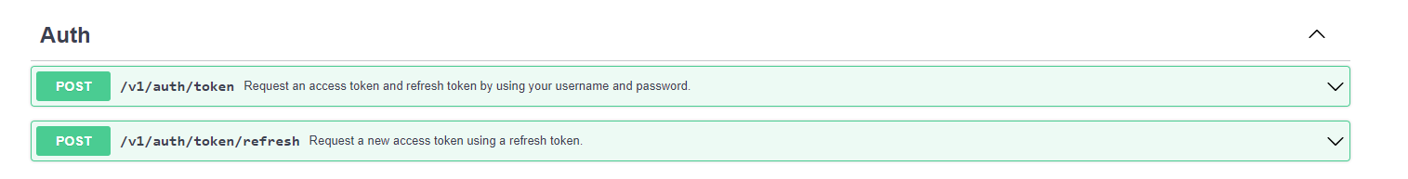
API Standards - Authorization

Slide 26
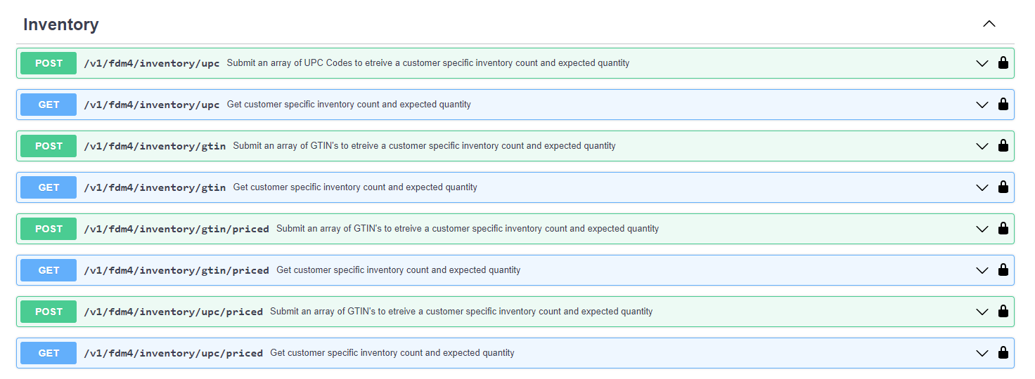
API Standards - Inventory

Slide 27
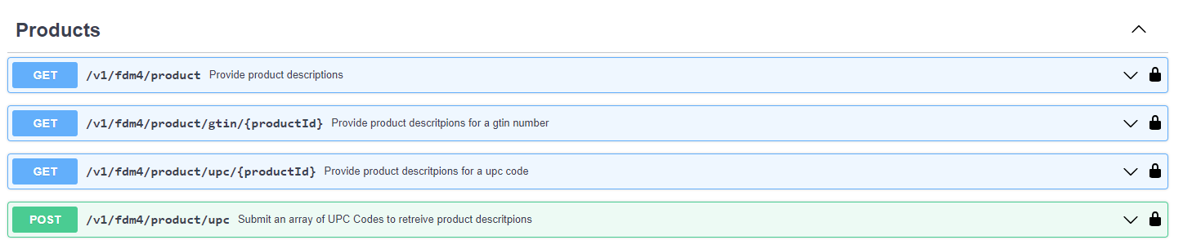
API Standards - Products

Slide 28
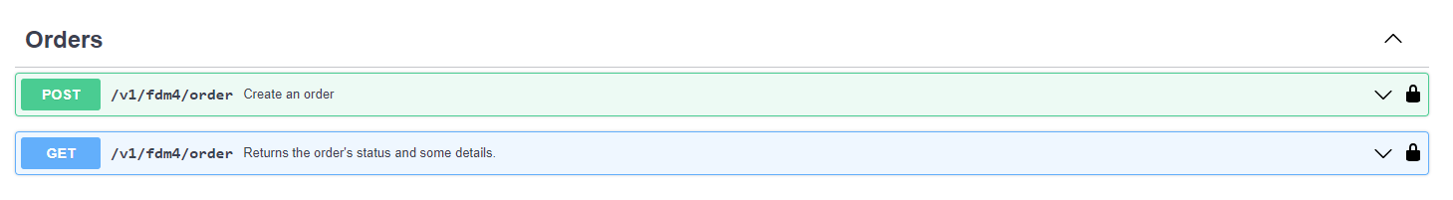
API Standards - Orders

Slide 29
API Standards - Up Next
Shipment notice
  EASI 856
Invoice
  EASI 810
Return
  EASI 180
Notes:
The next documents on the roadmap to be prototyped in Q1 2024 are.

Slide 30




API Standards - FDM4 Spotlight
Docker
  Container application development platform – virtualized OS layer
NGINX
  Web server which is being used to proxy web requests to Node.js
Node.js
  Highly scalable, efficient runtime environment
PostgreSQL
  Object Relational Database Management System
Notes:
FDM4’s implementation tech stack.
NGINX to proxy the node.js

Slide 31
API Standards - Demo
Notes:
FDM4’s implementation tech stack.
NGINX to proxy the node.js

Slide 32
Proposed EASI 830 – Forecast Document

Slide 33
Proposed EASI 830 - Forecast Document
Purpose
The 830 Forecast is an electronic document sent by the purchaser and received by the seller that provides item forecast quantities by week.
The standard assists the seller in manufacturing inventory for the needs of the purchaser.
Exported by the Purchaser
Imported by the Seller
.

Slide 34
Proposed EASI 830 - Forecast Document
Specific Benefits for Sellers
Provides communication of inventory requirements.
Increases production efficiencies by enabling accurate product production.
Increases visibility into the supply chain.
Increases order management efficiencies by enabling accurate inventory availability.
Automate receipt of forecast.
Specific Benefits for Purchasers
Increases order management efficiencies by enabling accurate inventory availability.
Mills can (Gildan will) consider the input as one of the most important key indicators to re-assess production plans.
Automate the transmission of forecast.
Reduction of processing time in implementing a new forecast improves the visibility of the customer needs at the mill’s supply chain.

Slide 35
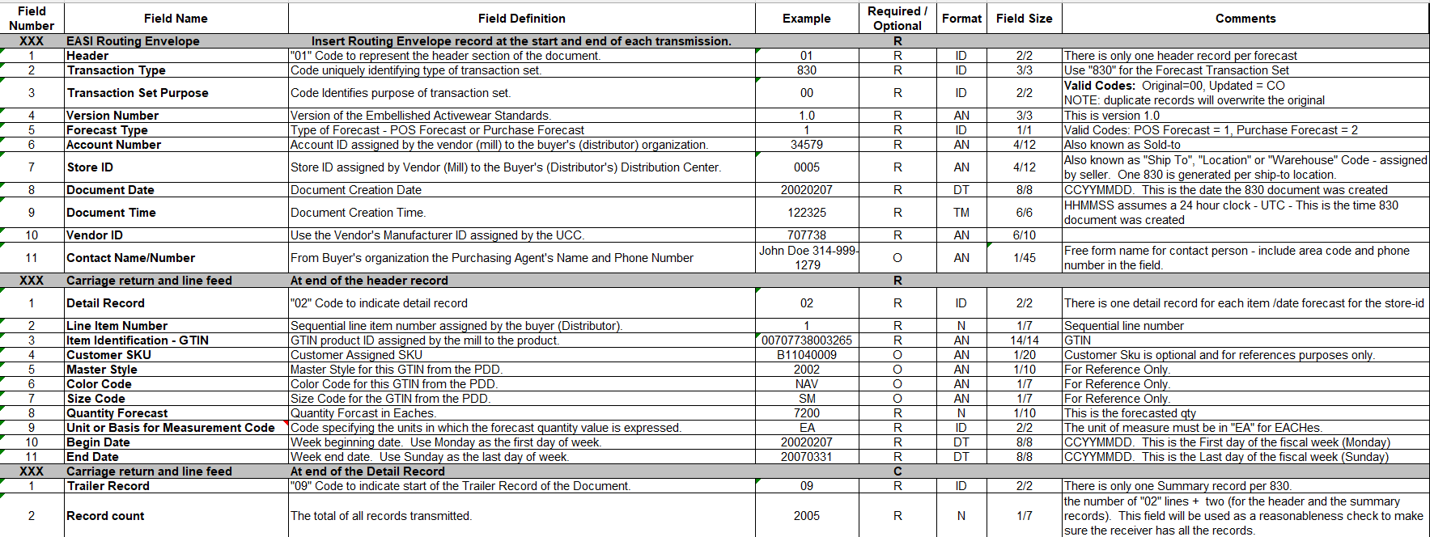
Proposed EASI 830 Forecast Document

Slide 36
Proposed EASI 830 Forecast Document
Discussions
Would a new 830 message will replace the schedule of the former planning schedule if one was sent?
Where would the supplier save this information and how would it be interpreted?

Slide 37


Open Discussions
940 Requirements
3rd Party Account Billing Address
870 Requirements
Require Expected Ship Date
Questions?
Notes:
Review 940 update proposed by Keith Schneider – Alphabroder (address requirements for 3rd party account number sent in 940).
Questions?

Slide 38
Proposed Changes to 940 Direct Ship PO
Issue - Vendors need the customer company name and address for the 3rd Party Account Number for account validation.
Suggestion - Add customer name and address of the 3rd Party Account Number.
Field Number | Field Name | Field Definition | Example | Required / Optional | Format | Field Size | Comments
52 | 3rd Party Account Name | 3rd Party account name to be charged for freight | John Doe Manufacturing | O | AN | 1/30 | This is an optional field. If the order is a 3rd party order, where the wholesaler's customer will pay the freight charges, enter the account company name to be charged for freight.
53 | 3rd Party Account Address | 3rd Party account name address | 123 Main Street | O | AN | 1/30
Do we need Field Numbers 54-57 for 3rd Party Account City Name, State Code, Postal Code, and Country Code?

Slide 39
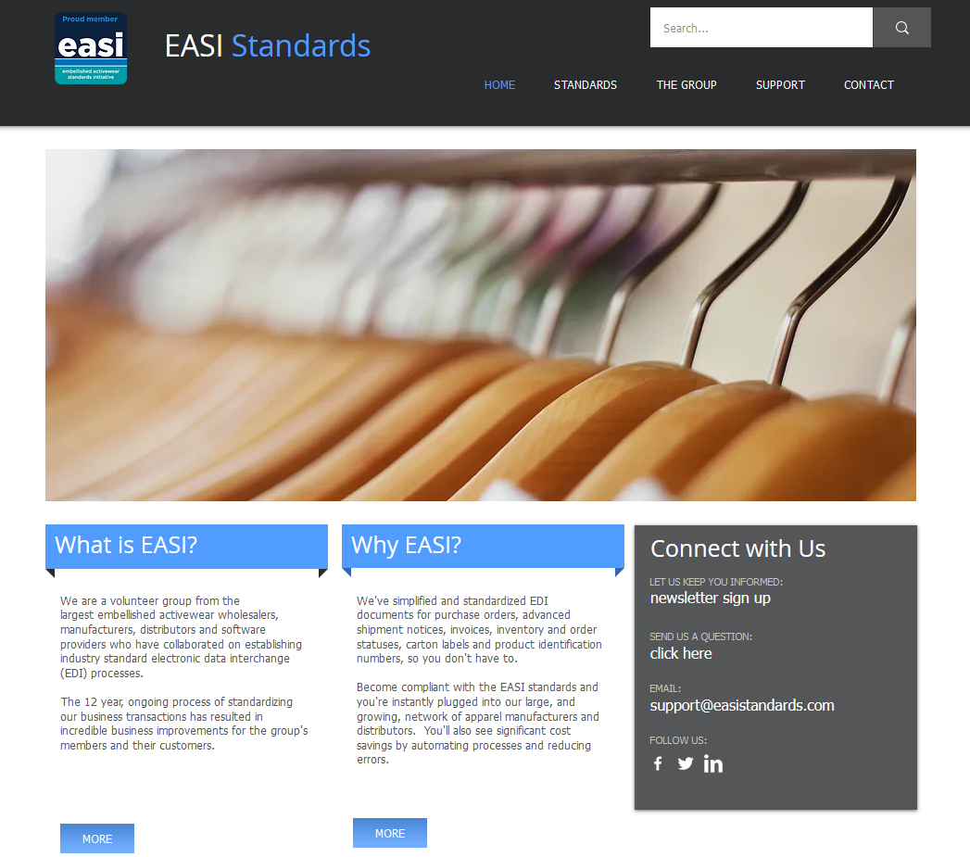
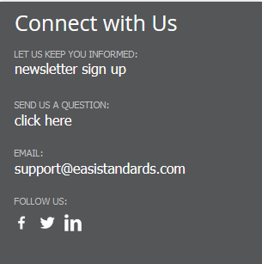
Increasing Membership
Engage the members and users

Slide 40




Increasing Membership
Engage the members and users

Slide 41

Increasing Membership
What are the advantages of being a member ?

Slide 42

2024 Meeting Location

