Slide 1


2020 EASI Meeting
Welcome to Charlotte NC!
March 19, 2020

Slide 2

Annual Meeting Schedule
Function | Time | Location
EASI/FDM4 Cocktail Reception | 5:30 pm – 6:30 pm | Ruth Chris Steakhouse
Wednesday March 18th
EASI/FDM4 Dinner | 6:45 pm – 9:00 pm | Ruth Chris Steakhouse
Thursday March 19th
Function | Time | Location
Breakfast | 7:15 am – 8:45 am | Gallery Kitchen
Tech Committee | 7:45 am – 8:30 am | Queen City room (I, II, & III).
Financial Audit | 7:45 am – 8:15 am | Queen City room (I, II, & III).
Steering Committee | 8:30 am – 9:00 am | Queen City room (I, II, & III).
EASI Annual Meeting | 9:00 am – 11:00 am | Queen City room (I, II, & III).
Morning Break | 11:00 am – 11:15 am | Pre-function space
EASI Annual Mtg (resumes) | 11:15 am – 12:30 pm | Queen City room (I, II, & III).
Lunch Break | 12:30pm – 1:30 pm | Gallery Kitchen
EASI Annual Mtg (resumes) | 1:30 pm – 3:00 pm | Queen City room (I, II, & III).
Afternoon Break | 3:00 pm – 3:15 pm | Pre-function space
EASI Mtg resumes | 3:15 pm - 4:15 pm | Queen City room (I, II, & III).

Slide 3
Antitrust Guidelines Review
It is the policy EASI and all attendees to comply fully with the antitrust and trade regulation laws of the United States Federal Government and of the various states. This meeting will operate to ensure compliance with the antitrust laws.
ANTITRUST GUIDELINES
The Antitrust laws prohibit agreements or understandings between two or more individuals or businesses to regulate prices or quantities of goods or services, to allocate customers or territories, to hinder or limit a competitor or potential competitor’s operations, or otherwise unreasonably to restrain business activity. Discriminatory pricing or servicing is also prohibited.
Ignoring these laws can be costly and dangerous. Violation of the Sherman Act is a felony: convicted individuals can be and have been imprisoned for up to three years; corporations are subject to heavy fines. Violators may also have substantial judgements for money damages entered against them. Every individual should, therefore, follow these rules:
DO NOT discuss your prices or competitors’ prices with a competitor (except when buying from or selling to that competitor) or anything which might affect prices such as cost, discounts, terms of sale, or profit margins.
DO NOT agree with competitors to uniform terms of sale, warranties, or contract provisions.
DO NOT agree with competitors to divide customers or territories.
DO NOT act jointly with one or more competitors to put another competitor at a disadvantage.
DO NOT try to prevent your supplier from selling to your competitor.
DO NOT discuss your future pricing, marketing, or policy plans with competitors.
DO NOT discuss your customers with your competitors.

Slide 4


Slide 5

Please introduce yourself …

Slide 6
Please designate your voting attendee

Slide 7
Thank you for your support in 2019
Patrons
American T Shirt Badger Sportswear Bella + Canvas
Century Place Apparel Dyenomite Apparel Fruit of the Loom/Russell
Gildan Activewear Hanes Brands J America Vetta​
LAT AppareL ML Kishigo Mfg. Co Moshay Inc / A4
Next Level / YS Garments One Stop Inc. S & S Activewear Inc
Sportsman Cap & Bag Order MyGear

Slide 8

2020 Annual Meeting
Anti-Trust Guidelines Review
--------
Secretary/Treasurer’s Report
--------
Steering Committee Members & Ballot
March 2020
Leslie Utt, Secretary/Treasurer
treasurer@easistandards.com

Slide 9

EASI Checking Account Summary
Activity Update for Fiscal Year 2019 – 2020
Reviewed by Rob Smith & Marvin Yoshizumi

Slide 10
2019 EASI Meeting Minutes
https://www.easistandards.com/2019-minutes

Slide 11
Thank you to all the 2019/2020
Steering Committee Members
Chair Diana Priebe
Vice Chair Marvin Yoshizumi
Secretary Treasurer Leslie Utt
Tech Committee Lead Joel Hotte/
Jon Clarke
Members at Large:
Debbie Krissinger
Michael Roberts
Jim Beale
Rob Smith
Derek Clarke
Beth Villa
Jim Sweeney
Heather Jenkins
Michael Sutton

Slide 12
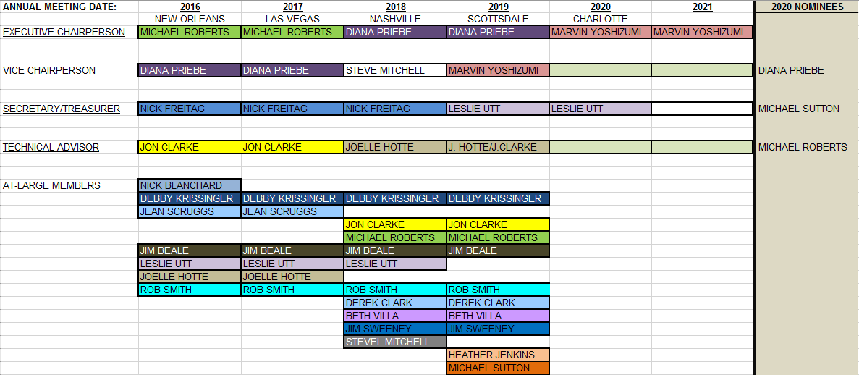
Elected Offices
BY-LAWS ARTICLE 7 - RULE 7.02 REQUIRES 'STAGGERED' TWO YEAR TERMS OF OFFICE FOR ALL POSITIONS
RULE 7.03 STIPULATES THAT VICE-CHAIR POSITION SHALL BECOME THE EXECUTIVE CHAIRPERSON ELECT
ARTICLE 8.02 - REQUIRES NOMINATING COMMITTEE PRESENT LIST OF NOMINEES TO STEERING COMMITTEE & DISTRIBUTE TO MEMBERSHIP AT LEAST 2 WEEKS PRIOR TO ANNUAL MEETING

Slide 13
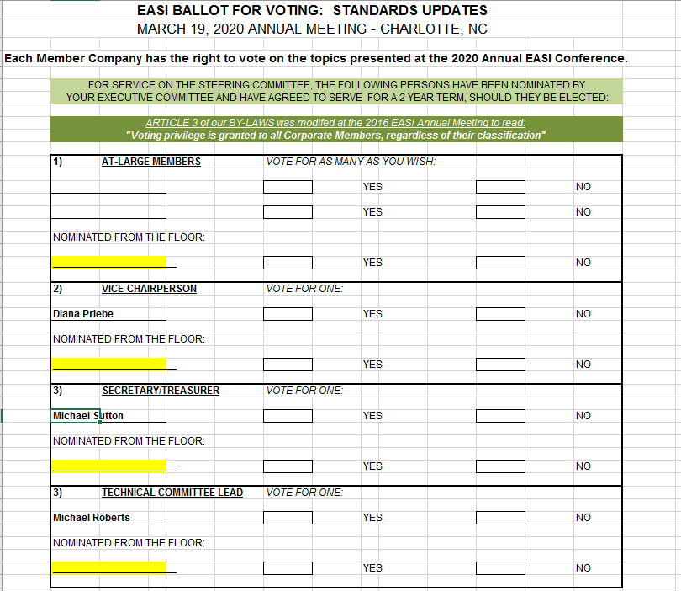
Elected Offices

Slide 14
NEW MEMBER

Slide 15


2019 Technical Committee Presentation

Slide 16
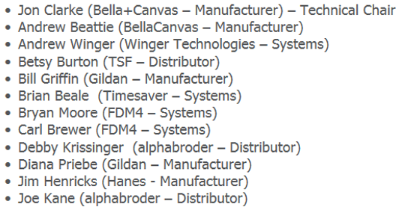
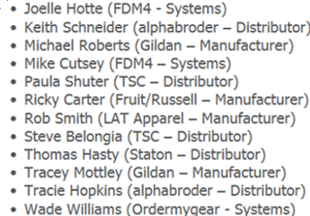
Team Acknowledgement
Thanks to all 2019-20 Technical Committee Members
Congratulations to Kristin Crawford who is now an official web developer for the EASI Group!

Slide 17
Agenda/ Discussion Items
    EASI Website
    New Business
    Web Services / API Discussion
    Open Discussion
    Tasks for 2020-2021

Slide 18
EASIStandards.com Website
Site Analytics
  6th year on Wix site
  5000 Sessions (same as last year)
  2200 Users (up 10%)
  78% New / 22% Returning Visitors
  Top Pages
    Standards Page, 856, 850, Annual Meetings, 846, Members, 940, 832, 852
  10 Support Emails Received + Many Direct Emails to Tech Committee Members
  Newsletter list growth flat (143 – up from 141)

Slide 19
EASIStandards.com Website
Additions
  General Housekeeping
  2019 Meeting Results/Minutes
  2020 Meeting Page
  EASI Cheat Sheet (Docs and Guidelines)
  SFTP Recommendation
  Steering/Tech Committee

Slide 20
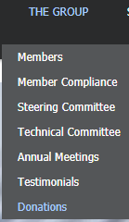
EASIStandards.com Website
Annual EASI Voluntary Donations
Donation Information
Donation Invoice
Link to Members Page
Online Payment Option

Slide 21
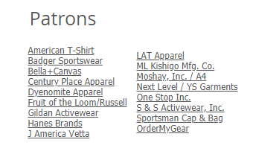
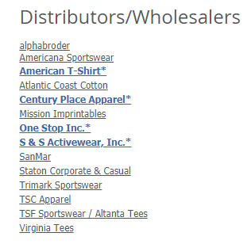

EASIStandards.com Website
Annual EASI Voluntary Donations

Slide 22
EASIStandards.com Website
Additions cont’d
  2019 Adopted Standards/Versions Published
    832 v9.0
    846 v4.0
    867 v1.0
    940 v4.1

Slide 23
EASIStandards.com Website
Additions cont’d
  Sample Files Added – All current versions
    832 v9.0
    846 v4.0
    850 v4.0 (Stock and Dropship)
    856 v7.0 (Stock and Dropship)
    867 v1.0
    870 v1.0
    940 v4.1
  Included some prior versions as well
  Reminder, sample files do not include routing envelopes.

Slide 24
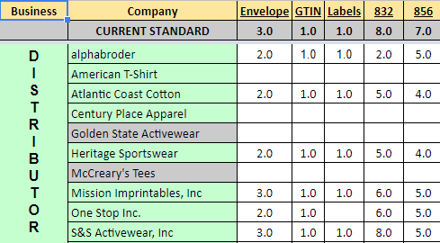
Compliance Matrix
Online Compliance Matrix v1.0 (link)
  Simplified Version Year 5
  Updated Current Standards/Versions
  Includes SFTP Compliance
  5 Member Updates Received
  Send updates to webmaster@easistandards.com!

Slide 25
Compliance Testing Site
Updated to include Current Versions
  832 v9.0
  846 v4.0
  867 v1.0
  940 v4.1

Slide 26
New Business Tasks
Duplicate GTIN Usage
Identify and provide clarification on documents which accept/do not accept duplicate GTINs.
Determinations based on common sense use cases, document intent, and experience.

Slide 27
New Business Tasks
Duplicate GTIN Usage
Allowed
  180 RA Request
  181 RA Authorization
  810 Invoice
  850 Purchase Order
  856 ASN
  870 Order Status
  940 Direct Ship PO

Slide 28
New Business Tasks
Duplicate GTIN Usage
Allowed - but not within a single Warehouse /Store / Location
  846 Inventory Status (DC ID)
  852 POS (Store ID)
  867 Monthly Resale Report (Store ID/Country/State)

Slide 29
New Business Tasks
Duplicate GTIN Usage
Not Allowed
  832 Product Descriptor Database
  Image Library
  Product Locator URL Link

Slide 30
New Business Tasks
Duplicate GTIN Usage
Not Applicable
  821 Account Statement
  861 Inventory Receipt Advice (v1.0)
  997 Functional Acknowledgement

Slide 31
New Business Tasks
Duplicate GTIN Usage
Vote to adopt these rules as described
Update each applicable standard with appropriate clarification
  GTIN Field - Comment
  General Info
Discussion
Motion / Vote

Slide 32
New Business Tasks
EASI Meeting Cheat Sheet
Informational Reference Document
  Common Group References, Terminology, Abbreviations
  Standard Definitions and Directional Flow
Please provide feedback
Update Website with Feedback and Glossary

Slide 33
New Business Tasks
Decoration Handling
Would it benefit the membership if we implement a method for customers to transmit their decoration instructions in a standard format?
The purpose of our organization is to standardize the exchange of business transactions

Slide 34
New Business Tasks
Decoration Handling
What type of decorations are requested?
  Screen Print
  Label Change
  Pad Print
  Heat Seal
  Embroidery
  What else?

Slide 35
New Business Tasks
Decoration Handling
What decoration information might need to be provided?
  Decoration type
  Placement of decoration
  Dimensions of decoration
  Artwork (New/Existing)
  Thread color, type, stop/start
  Comments or Special Instructions
  What else?

Slide 36
New Business Tasks
Decoration Handling
How are decorations being handled today?
  Manual?
  Custom EDI?
  Promo Standards Web Service?
Transactions potentially affected
  850/940 PO?
  856 ASN / 810 Invoice?
  New Standard?

Slide 37
New Business Tasks
Decoration Handling
How should this information be communicated?
  API or ftp EASI transaction?
What are the advantages/disadvantages of each method?
Discussion and Directives

Slide 38
New Business Tasks
FTP Sunset Date Proposal
SFTP adopted as recommended communication method in 2019
Unsecured FTP communications are a serious security risk

Slide 39
New Business Tasks
FTP Sunset Date Proposal
Why are secure communications important?
  Average cost of a security breach globally – 3.92 Million (IBM)
  Average cost of a security breach in the United States – 8.19 Million (IBM)
  User/Password sniffing attacks common as far back as the 1990’s.
  Practically impossible to achieve regulatory compliance when using FTP.

Slide 40
New Business Tasks
FTP Sunset Date Proposal
Why are secure communications important?
  In early 2017 the FBI warned of cyber criminals targeting FTP servers.
It is irresponsible for the EASI Group not to sunset the use of unsecured FTP with its members.

Slide 41
New Business Tasks
FTP Sunset Date Proposal
What is SFTP?
  Secure Transfer Protocol
  Encrypts command (user names / passwords) between the client (local machine / server) and the FTP server.
  Encrypts data connections (contents of the files transferred) between the client and the FTP server.

Slide 42
New Business Tasks
FTP Sunset Date Proposal
Proposal – FTP Sunset Date 12/31/20
Provides 9 months for required changes to be implemented:
  Management Buy-In
  Script Updates
  Technical Infrastructure Changes
Discussion
Motion / Vote

Slide 43
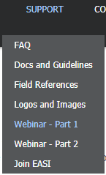
New Business Tasks
EASI Webinar
Q2 2020 – APRIL 24, 2020
Will be hosted by Andrew Beattie (Bella+Canvas)
Redux of original 2011 Webinar
Based on Attendance additional Webinar will be conducted Q4 2020

Slide 44
New Business Tasks
EASI Webinar
Q2 2020 Webinar will cover
  Basics of EDI
  EASI History
  GTINs
  Carton Labels
  Routing Envelopes
  832 PDD
  850/940 PO’s
  856 ASN

Slide 45
New Business Tasks
EASI Webinar
Webinar Tech Committee Support
  Bryan Moore (FDM4)
  Kristin Crawford (Bella+Canvas)
  Tracie Hopkins (alphabroder)
  Additional Volunteers?
Request attendees share with appropriate company personnel
  Webinar Communications via EASI Newsletter)
  Subscribe from Homepage – Newsletter Sign Up

Slide 46
New Business Tasks
EASI Webinar
Sessions and Feedback will allow us to create additional documentation for our Support pages

Slide 47
New Business Tasks
Trading Partner Portal
Task has been put on hold
Will address with API Standards Adoption
  Trading Partner Self-Registration
  API Access Request / Credential Assignments
  API Documentation

Slide 48
New Adoption Discussion
EASI Email Standard v1.0
Establish EASI Email Convention Standard
Improve trading partner communications
Support General or Urgent EASI Communications between trading partners
Does not replace existing function-specific communications

Slide 49
New Adoption Discussion
EASI Email Standard
Convention
  EASI@<trading partner email domain>
Examples
  EASI@alphabroder.com
  EASI@bellacanvas.com
  EASI@latapparel.com

Slide 50
New Adoption Discussion
EASI Email Standard
Up to the trading partner if this is a monitored Mailbox, Alias or Distribution List
Update Compliance Matrix to indicate availability by member company
Future versions could be more granular
  Ex: EASI.Order@ | EASI.Inventory@
Discussion
Motion/Vote

Slide 51
New Adoption Discussion

Slide 52
EASI 870 Changes Proposed (V 2.0)
EASI 870 Open Order Report – used for order reconciliation and ETA
The current standard of the EASI 870 does not allow for a granular enough break down of the order status. We are having many challenges with its interpretation.
Current Challenges
Proposed Solution

Slide 53
EASI 870 Changes Proposed (V 2.0)
Current Challenges:
Definition of the status of the order is needed
  Open = order that has not been allocated
  Partially Shipped = order that has an open quantity that has not been allocated but part of the quantity ordered has already shipped?
  Allocated – quantity of item is allocated (has all the quantity of the item been allocated?) Has a quantity already shipped? Is there a quantity in process?
  In Process (of shipping) – the item is in process of shipping – but how much of it? Is some still open or remained allocated but is not yet in the process of shipping?

Slide 54
EASI 870 Changes Proposed (V 2.0)
Proposed Solution:
Adapt the EASI 870 to do both ETA report and Order Status/Reconciliation with clear definitions and buckets of quantities.
The new fields are optional which allows Mills/Distributors to use the document with its current interpretation.
The status that is displayed on the report is the most advanced status of the current open order. If part of the quantity is allocated however another portion of the quantity is in process, Process would be reported.

Slide 55
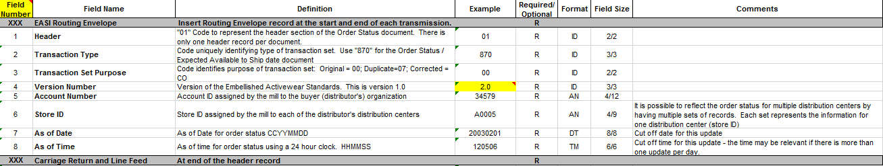
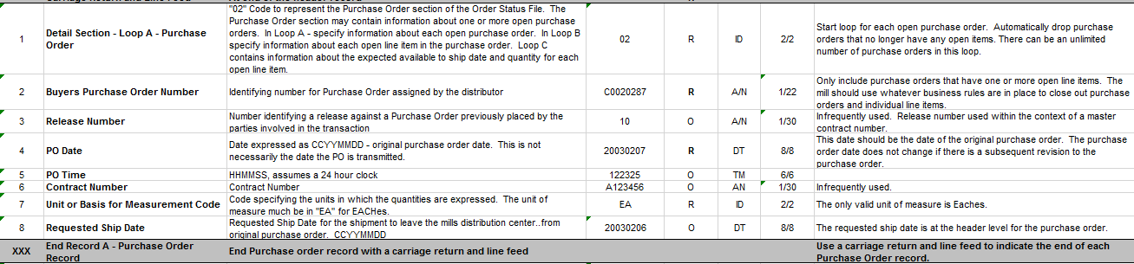
EASI 870 Proposed Specifications

Slide 56
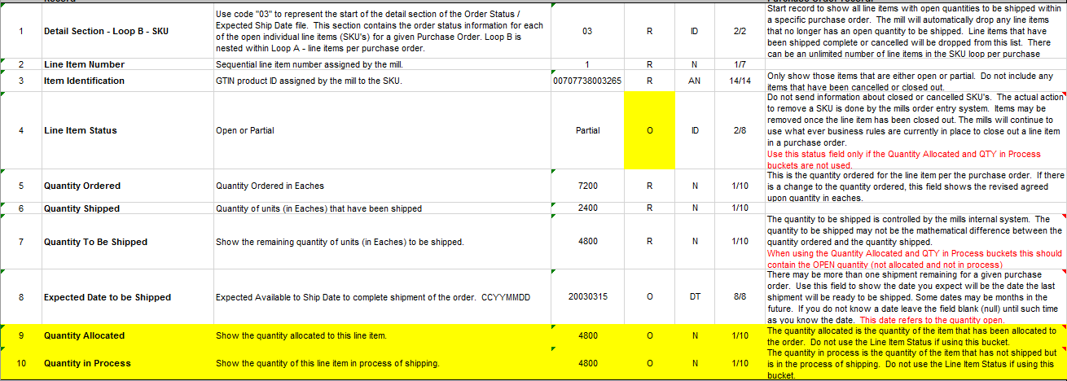
EASI 870 Proposed Specifications

Slide 57
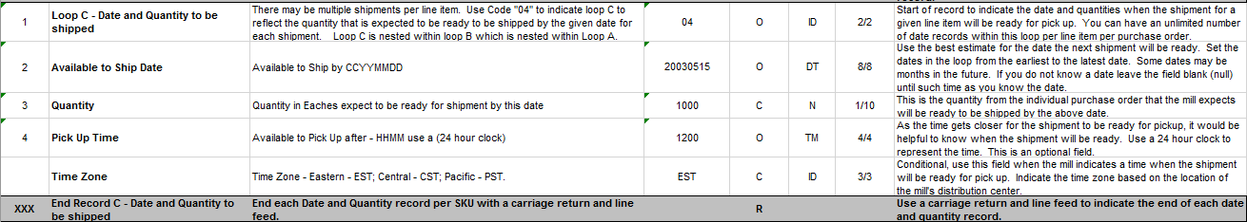
EASI 870 Proposed Specifications

Slide 58
EASI 870 Proposed Specifications
Upcoming API-based Order Endpoint Capabilities
  Solution defined challenges
  Support granular needs
  Support additional data elements
Discussion
Motion / Vote

Slide 59
Retire Standards –

Slide 60
Standard Usage – 997 FA
The decade of the 997!
Is the need for utilizing acknowledgments not present?
Put the Function in Functional Acknowledgement.
What is preventing true adoption/usage?

Slide 61
Standard Usage –

Slide 62
New Standard – EASI 888 Item Maintenance
What is an EASI 888 - Item Maintenance Transaction?
An EASI 888 transaction set enables a Mill to provide detailed information of finished goods to a specific partner. The EASI 888 is useful in providing information regarding new products or any changes in existing specifications of an item.
Reduces/Eliminates the need to generate and send large PDD files.

Slide 63
EASI 888 Proposed Specification

Slide 64
New Business – Topics
Trading Partner EASI Meeting Breakout
RFID Usage/Adoption

Slide 65
New Business – Topics
Trading Partner Breakout Sessions
  Has been an informal benefit of our meetings
  Is it time to provide a defined opportunity at the Annual Meetings?
  Opportunity for trading partners to meet privately and discuss:
    Their EASI Needs and Priorities
    Challenges
    Establish/Reinforce communications
    Commitments for progress

Slide 66
New Business – Topics
Trading Partner Breakout Sessions
  What might this look like?
  Group can coordinate scheduling of meetings.
  Would this mechanism result in more actionable requests and compliance progress?

Slide 67
New Standard – EASI 888 Item Maintenance
What is an EASI 888 - Item Maintenance Transaction?
An EASI 888 transaction set enables a Mill to provide detailed information of finished goods to a specific partner. The EASI 888 is useful in providing information regarding new products or any changes in existing specifications of an item.
Reduces/Eliminates the need to generate and send large PDD files.

Slide 68
New Business –

Slide 69
    Web Services / API Discussion

Slide 70
Open Discussion
Questions
New Tech Business

Slide 71
2019-2020 Potential Tech Tasks
Cheat Sheet – Feedback Update and Website Glossary
New Standard Development
Sample Files - New Standards/Versions
RFID Version Updates
API’s – Phase 1 Standards Proposals
  Inventory Endpoint v1.0 (Get/846)
  Order Endpoint (Get/870)
  Fulfillment Endpoint (Get/856)
Webinar or Q&A Open Call
?

Slide 72
2020 Meeting Wrap Up
Meeting Review / Feedback
2021 Location Suggestions
(West Coast)

Slide 73
Thank you for attending the
2020 EASI Conference
Hope to see you again next year!

